Slide 1
Getting started with
Awareness between ledger settlement and year–end close
Presenter:
Henrik Jaeger – Sr. FastTrack Solution Architect
Moderator/Q&A:
Saurabh Bharati – Sr. FastTrack Solution Architect
Notes:
Saurabh:
Hello everyone and welcome to today's Dynamics 365 TechTalk. Today's topic is ’Getting started with Awareness between ledger settlement and year-end close’. My name is Saurabh, and I will be your moderator today.
We are broadcasting this session through Teams Town Hall. This session is being recorded on behalf of the Microsoft Corporation. When you join this event, your name and e-mail address may be viewable by session organizers. By joining you're agreeing to this experience. If you do not consent to be a part of a recorded session, please disconnect your line at this time. The recording will be made available in the TechTalk section of Community Dynamics page within 5 business days.
If you have questions for the presenter or need support, please use the Q&A panel located on the right side of your screen. If you wish your name not to be visible to organizers or session participants, please post your questions anonymously. We will be responding to your questions throughout the session and in a live segment at the end of the presentation. ​​​​​​​
Thank you for your patience during these announcements.
Presenting for us today from Microsoft we have Henrik, Senior FastTrack Solution Architect.
Henrik, over to you!

Slide 2
TechTalk Series
Session 1 – Getting started with Awareness between ledger settlement and year-end close
Session 2 – Adopting Awareness between ledger settlement and year-end close after go-live (scheduled for September 25, 2025)
Notes:
This is the first TechTalk in a series of 2 TechTalks that will dive into the details of the Awareness between ledger settlement and year-end close in Dynamics 365 Finance. This TechTalk will be focusing on the standard functionality around awareness between ledger settlement and year-end close and the recommended configuration for a new legal entity in D365FO. Then in part 2 we will dive into how you can review the inventory closing process and we will wrap up the series with the new global inventory accounting add-in.

Slide 3
Take aways
Understand the standard functionalities around ledger settlement and year-end close
Understand the differences between year-end close with and without awareness between ledger settlement and year-end close enabled
Recommendations on configuration of parameters
Understand how to adopt Awareness between ledger settlement and year-end close before go-live

Slide 4
Ledger settlement and the challenges at fiscal year end

Slide 5
Ledger settlement
What is ledger settlement
Matching corresponding debit and credit transactions
Why use it
Key part of fiscal period close
Improves financial accuracy
Enhances auditability and control
Notes:
Ledger settlement is the activity of matching corresponding debit and credit transactions
It is a key part of the fiscal period close activities
Why use it
Improves financial accuracy
Ensures that ledger account balances reflect only unresolved items by matching offsetting transactions
Can help catch duplicate entries
Enhances auditability and control
Creates clear links between related entries, simplifying audit trails and reconciliation.
Provides control over the period end balance

Slide 6
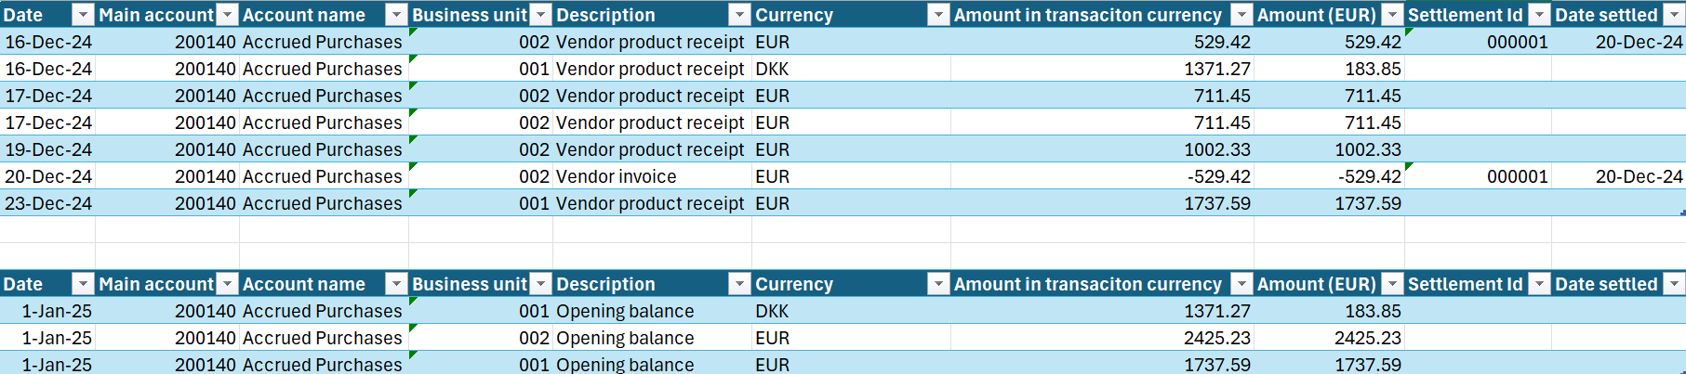
Year-end close prior to awareness between…
Balance transferred as summary by transactions currency, by dimension combination

Slide 7
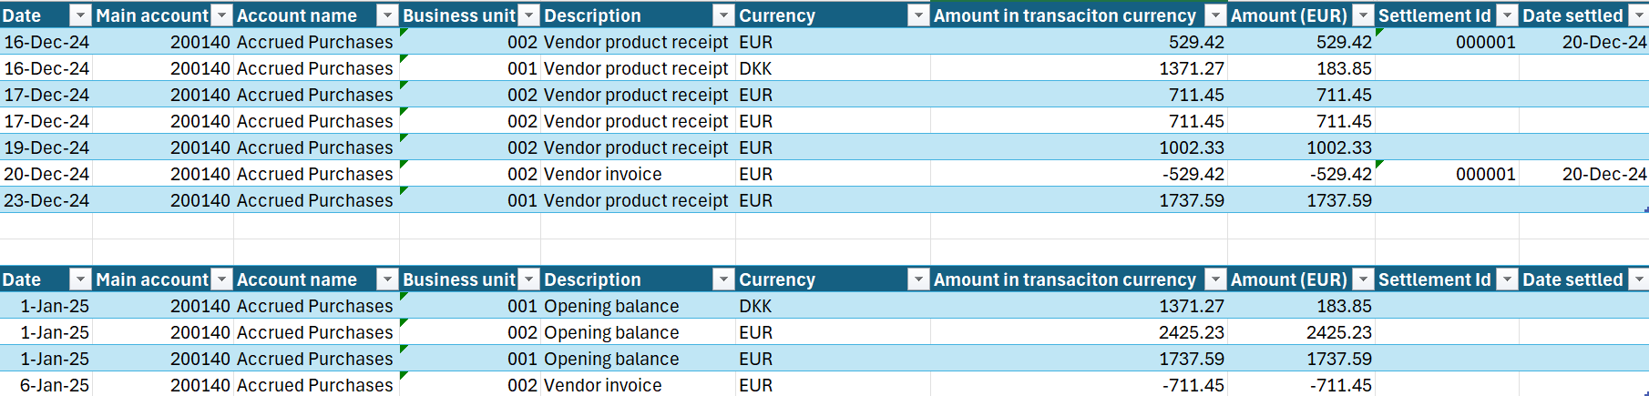
The challenge
In the new year, ledger settlement of the opening balance is a challenge
Transaction details for ledger settlement has been lost

Slide 8
Introducing Awareness between ledger settlement and year-end close

Slide 9
Awareness between ledger settlement and YeC
What
Provides a way to keep details when creating opening transactions for a new fiscal year for the main accounts that require this detail
Key changes
Only un-settled transactions are included in year-end close
Ledger settlement must be within one main account
Ledger settlement cannot be across fiscal years
If the Keep detail during year-end close option is marked, the year-end close will create detailed opening balance transactions
Notes:
So, what changes does the awareness options introduce compared to the

Slide 10
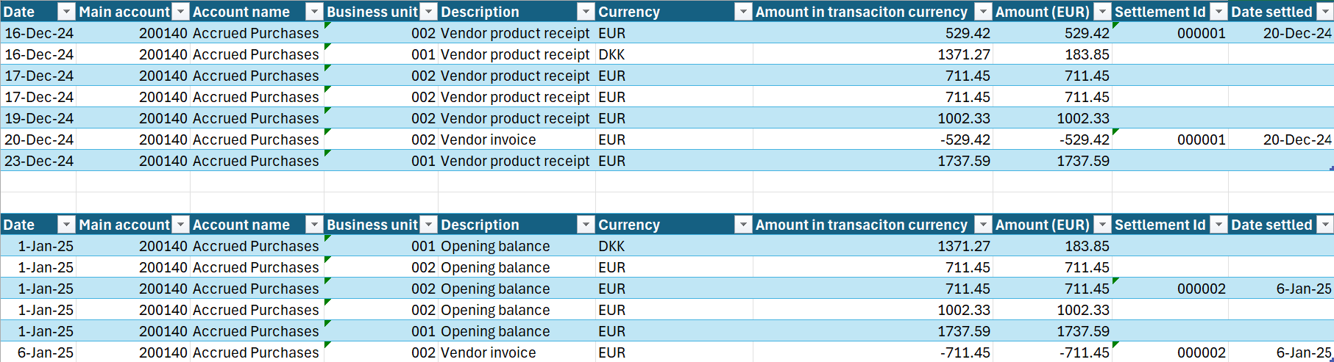
Detailed opening balances and settlement in new year

Slide 11
Now we can settle transactions in the new year

Slide 12
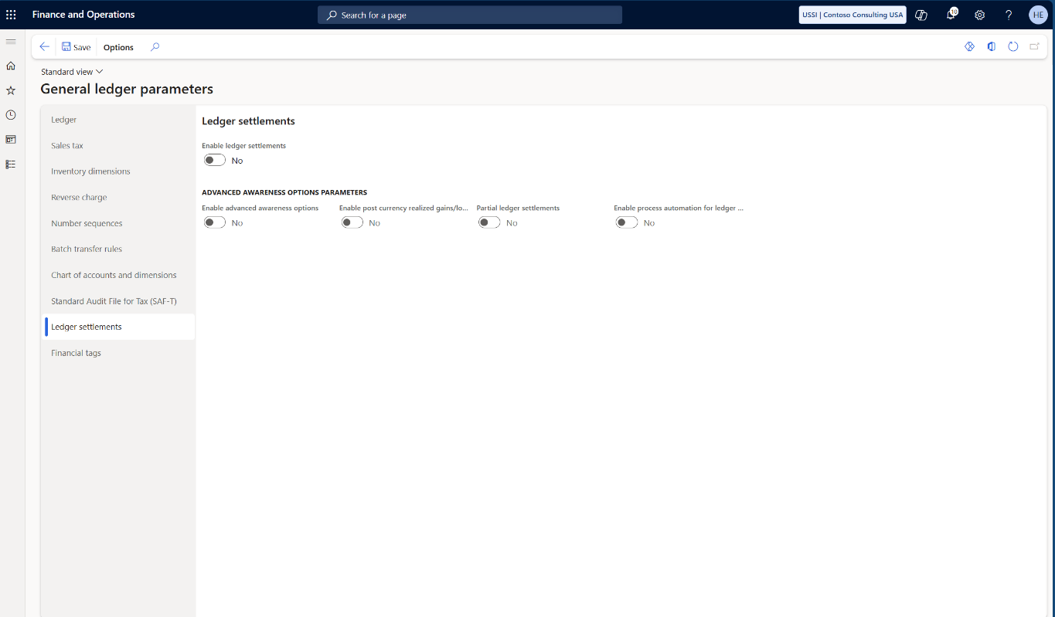
Awareness options – GL parameters
Notes:
You can find the configuration for awareness between ledger settlement and year-end close in the General Ledger parameters
First of all, the options are depending on Ledger Settlement being enabled

Slide 13
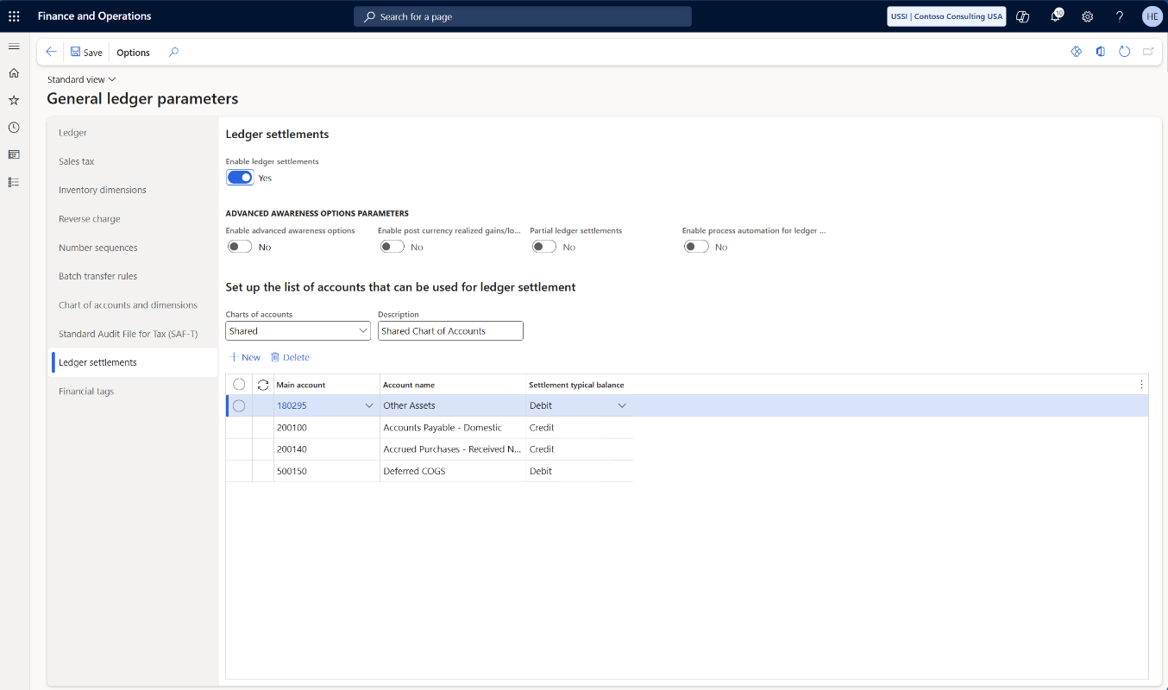
Awareness options – GL parameters
Notes:
When Ledger settlement has been enabled, it is possible to enable the advanced awareness options

Slide 14
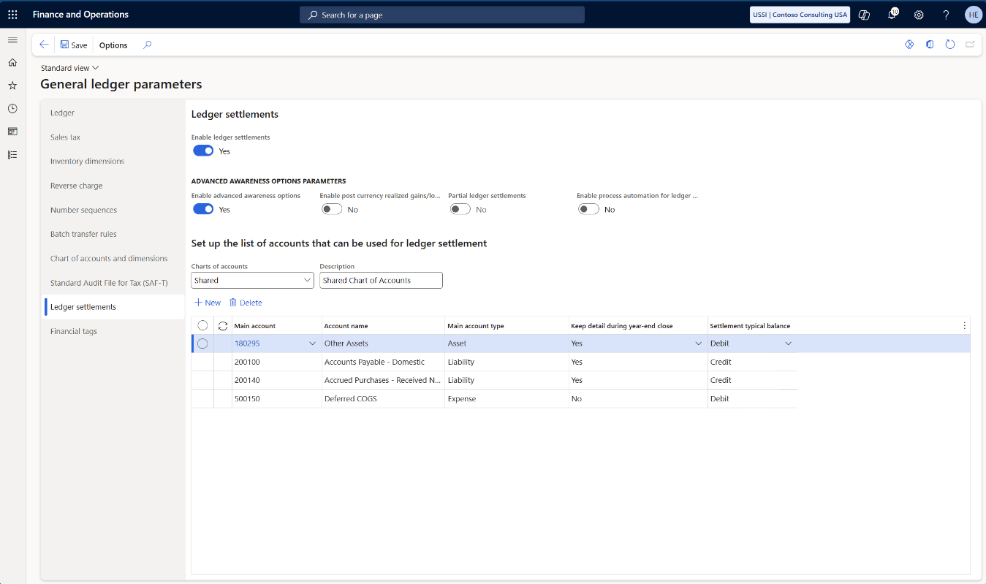
Awareness options – GL parameters
Notes:
When you enable the advanced awareness options, you’ll see two additional columns being visible in the list of accounts that can be used for ledger settlement
Most importantly is the “keep details during year-end close”
If this is set to “yes”, then detailed opening transactions will be created in the new fiscal year
Only Balance sheet accounts (including Assets and Liabilities account types) can be set to “yes”
However, you may want to use ledger settlement in a Profit and Loss account, hence the Main account type is also displayed
At year end close, the profit and loss accounts are transferred to the retained earning account without details
Please be aware that when you have enabled advanced awareness option in a live production environment, it is strongly advised not to disable it again!

Slide 15
Nice to know about Awareness between…
If “Keep detail during year-end close” is enabled, the detailed opening transactions will have the following information transferred from the original transactions:
  Original transaction date
  Original document date
  Original document

Slide 16
Recommendation(s)
Always enable advanced awareness options when setting up a new legal entity
  If you do not want to use ledger settlement at all – leave the main accounts to be used for ledger settlement empty
  If you do not want to keep details for main accounts – set “keep detail during year-end close” to “No”
Notes:
It is recommended to always enable advanced awareness options when setting up a new legal entity – this prevents settlement across fiscal years and other potential problems (that will be covered in the second session next week)

Slide 17
What changes are introduces with awareness options
Only un-settled transactions are included in year-end close
Ledger settlement must be within one main account
Ledger settlement cannot be across fiscal years
If the Keep detail during year-end close option is marked, the year-end close will create detailed opening balance transactions
Notes:
So, what changes does the awareness options introduce compared to the

Slide 18
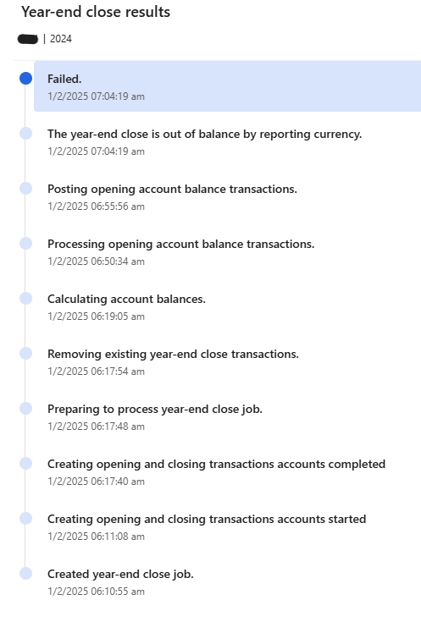
I enabled “awareness options”, but it didn’t work…
Find a better slide title!
Year-end close fails
This is caused by changes made to how year-end close is performed with and without “advanced awareness options” enabled

Slide 19
What is different about “awareness options” and YeC
Only un-settled transactions are included in year-end close
Ledger settlement must be within one main account
Ledger settlement cannot be across fiscal years
If the Keep detail during year-end close option is marked, the year-end close will create detailed opening balance transactions

Slide 20
What is different about “awareness options” and YeC
Only un-settled transactions are included in year-end close
Ledger settlement must be within one main account
Ledger settlement cannot be across fiscal years
If the Keep detail during year-end close option is marked, the year-end close will create detailed opening balance transactions

Slide 21
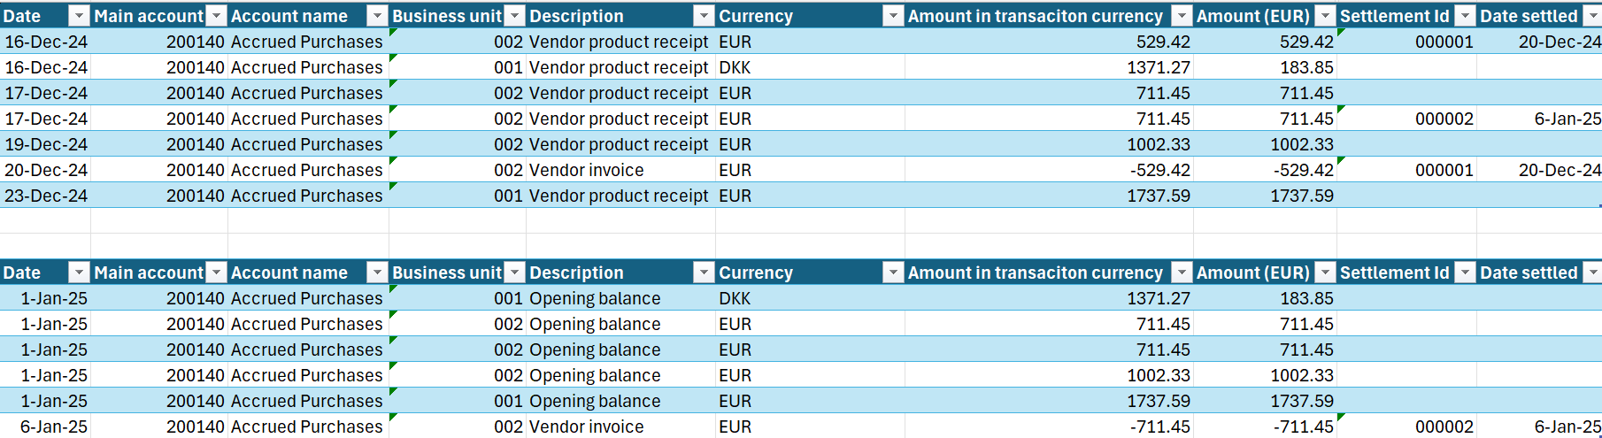
Settlement across fiscal years

Slide 22
Settlement across fiscal years
Only un-settled transactions are included in year-end close
Ledger settlement can’t be across fiscal years
Result = Year 2024 is out of balance by accounting currency

Slide 23
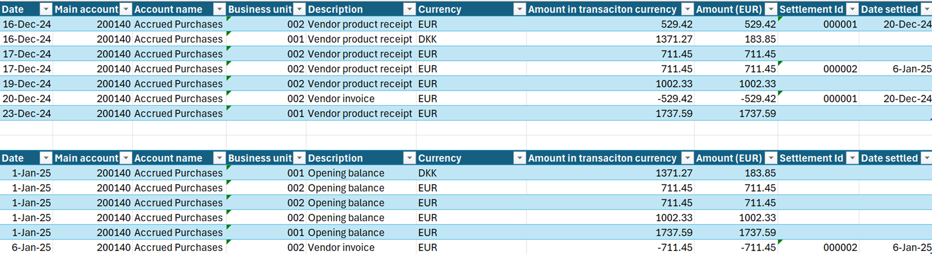
Reporting currency gain/loss

Slide 24
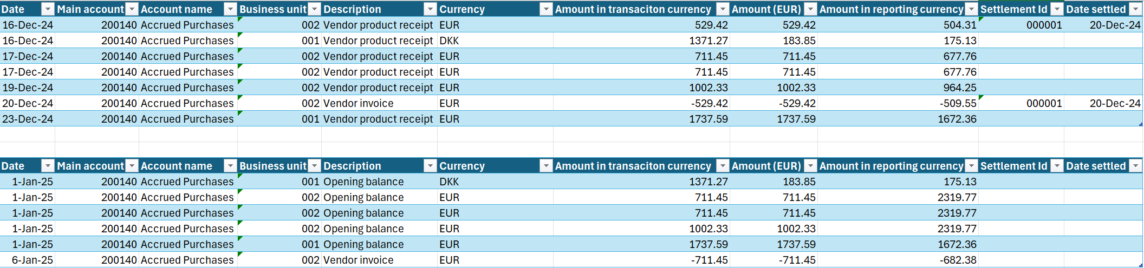
Reporting currency gain/loss

Slide 25
Reporting currency gain/loss
Only un-settled transactions are included in year-end close
Result = Year 2024 is out of balance by reporting currency

Slide 26
I enabled “awareness options”, but it doesn’t work…
Year-end close fails
  Accounting currency is out of balance
    Settlements across fiscal years
  Reporting currency is out of balance
    Currency gains/losses not accounted for in reporting currency

Slide 27
Automating ledger settlements
Notes:
Manually performing the ledger settlement can be a cumbersome process, especially in large enterprises with tens of thousand, hundreds of thousand or maybe even millions of transactions – hence the introduction of process automation for Ledger settlement

Slide 28
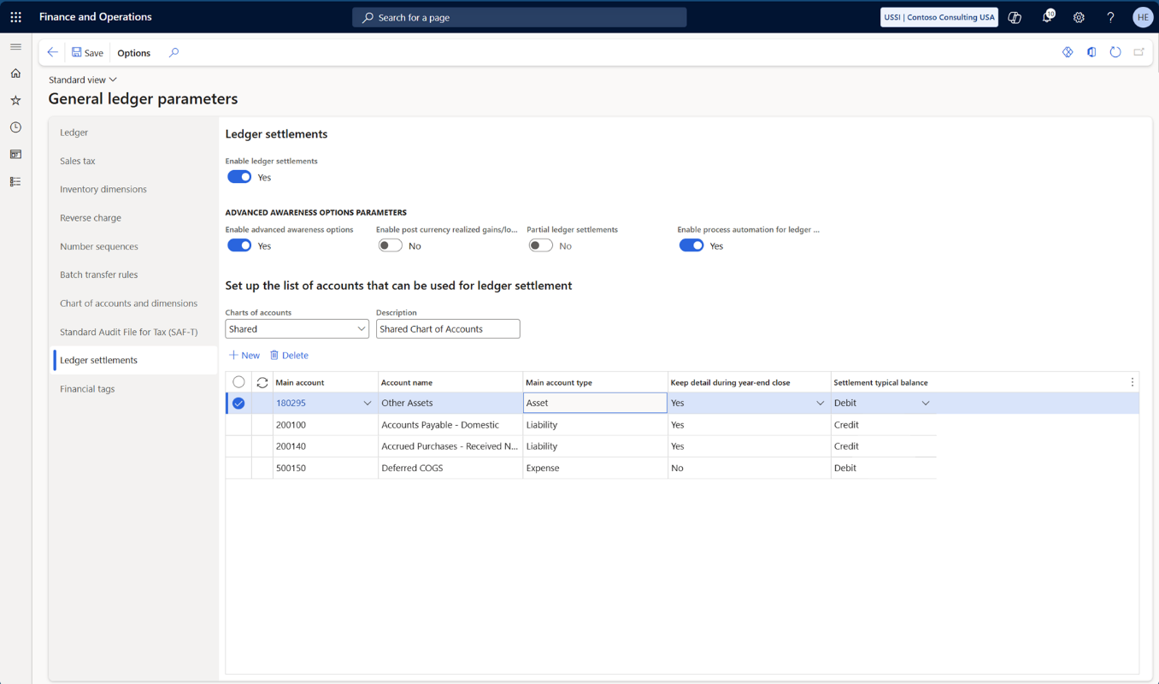
Automating ledger settlements
Notes:
You can enable the process automation for ledger settlement
No additional columns are being made visible, but the columns “settlement typical balance” will be used by the ledger settlement automation to determine how to settle the ledger transactions
If it is “debit”, then it will start with from debit transaction and identify matching credit transaction – and vice versa if it is set to “credit”

Slide 29
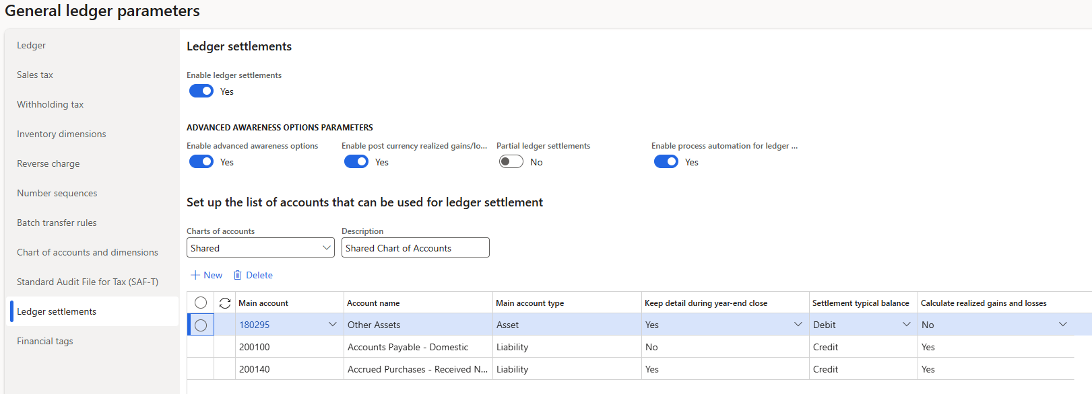
Automatic ledger settlements

Slide 30
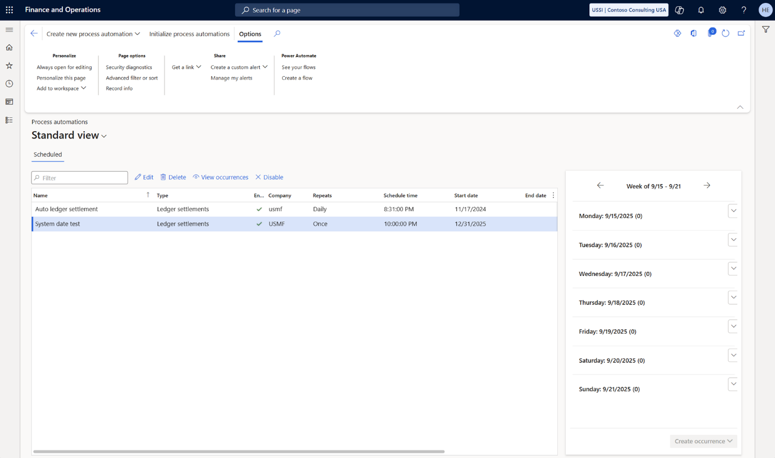
Create process automation for ledger settlements
Notes:
The process automation for ledger settlement is configured, under Ledger Setup and Process automation

Slide 31
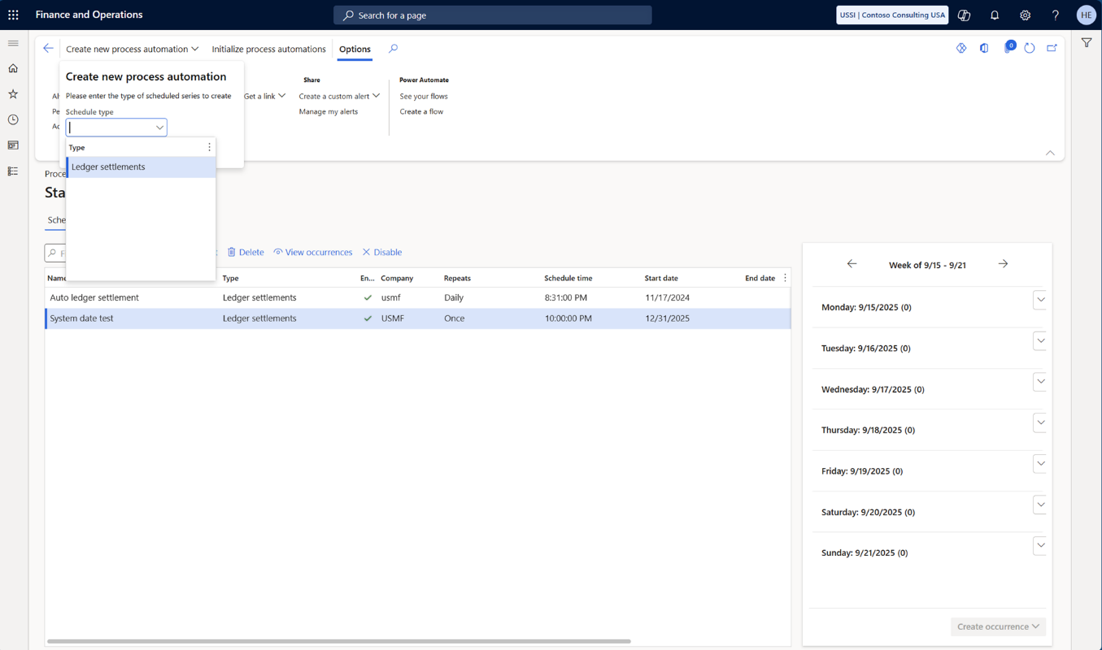
Create process automation for ledger settlements
Notes:
Create new process automation and select ledger settlement

Slide 32
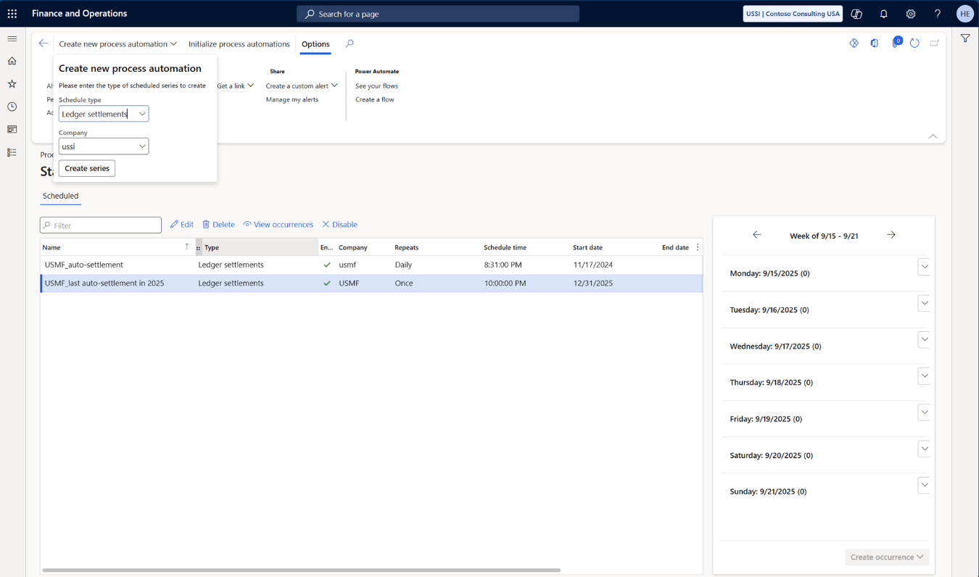
Create process automation for ledger settlements
Notes:
Select the process automation type for ledger settlement – and specify the legal entity that you want to run the automatic ledger settlement in

Slide 33
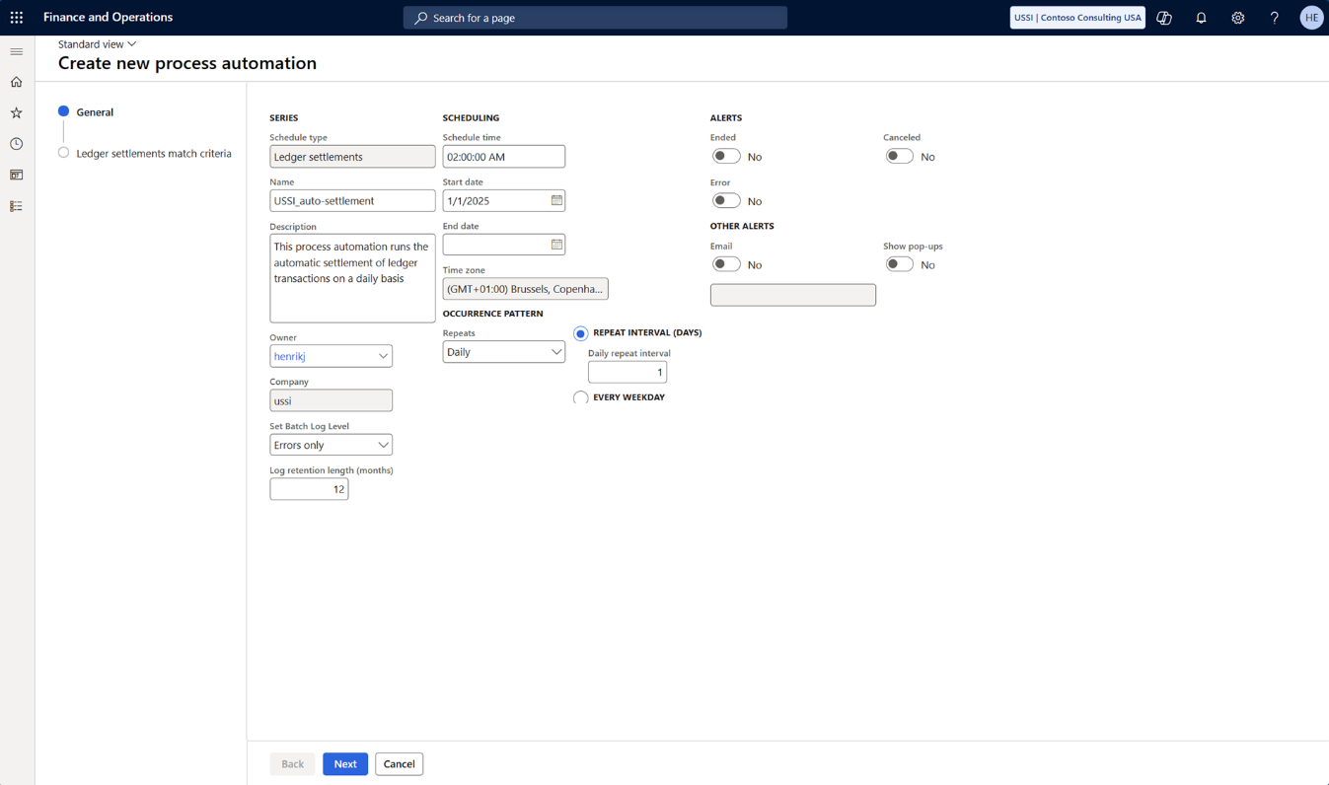
Create process automation for ledger settlements
Notes:
As a minimum, proivde a unique name
The schedule time (time of day that the automatic settlement will run)
The start date (the first day that the automatic settlement will run)
The occurrence pattern (daily, weekly, monthly or once)

Slide 34
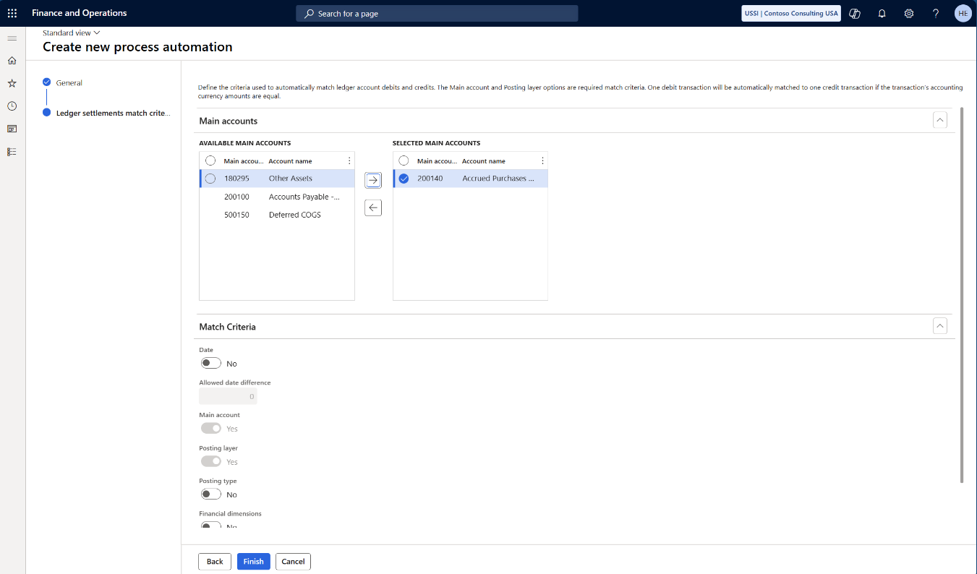
Create process automation for ledger settlements
Notes:
Select the main account (or accounts) that should be included in the automatic ledger settlement

Slide 35
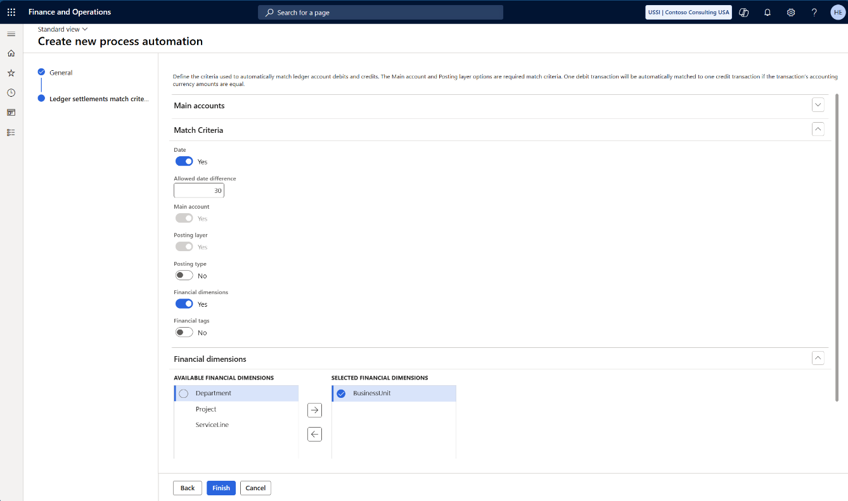
Create process automation for ledger settlements
Notes:
Then you can configure the match criteria:
Date (if enabled, you can specify an “allowed date difference”)
Main account and posting layer are enabled by default and cannot be disabled
Posting type (if you only want to settle debit and credit transactions that has the same posting type – e.g. on a purchase order accrual account, the debit and credit transactions posted from the purchase order will not have the same posting type)
Finally, you can specify which financial dimensions and/or financial tags to include as match criteria
Be aware that a blank financial dimension or financial tag is a valid match criteria

Slide 36
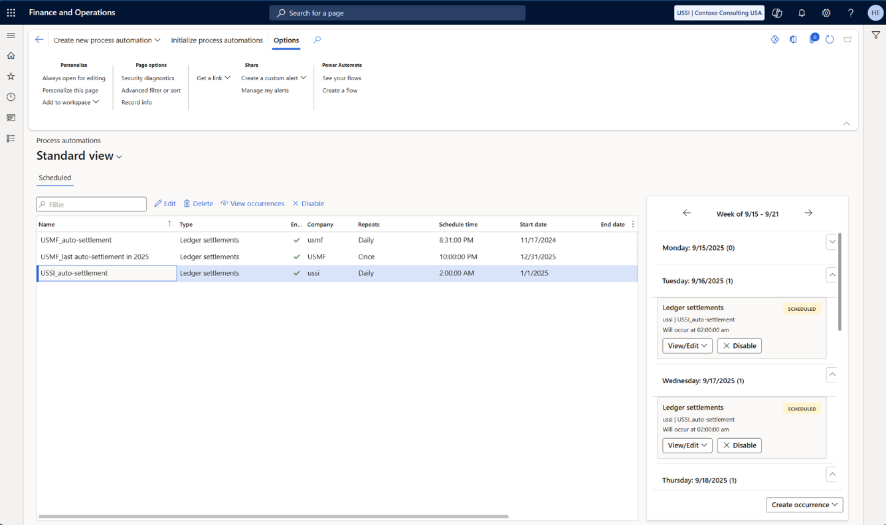
Create process automation for ledger settlements
Notes:
Then you can configure the match criteria:
Date (if enabled, you can specify an “allowed date difference”)
Main account and posting layer are enabled by default and cannot be disabled
Posting type (if you only want to settle debit and credit transactions that has the same posting type – e.g. on a purchase order accrual account, the debit and credit transactions posted from the purchase order will not have the same posting type)
Finally, you can specify which financial dimensions and/or financial tags to include as match criteria
Be aware that a blank financial dimension or financial tag is a valid match criteria

Slide 37
Nice to know about automatic ledger settlement
Process automation for ledger settlement will
Settle one debit to one credit transaction with balancing accounting currency
  Partial settlements are not supported by process automation
Execute on the schedule time specified in the setup
  Be aware of the last day of the fiscal year

Slide 38
Recommendation(s)
Always enable Process automation for ledger settlements
  If you do not want to use automatic ledger settlements – leave the process automation for ledger settlement empty
Notes:
It is recommended to always enable advanced awareness options when setting up a new legal entity – this prevents settlement across fiscal years and other potential problems (that will be covered in the second session next week)

Slide 39
Handling currency gains/losses in reporting currency

Slide 40
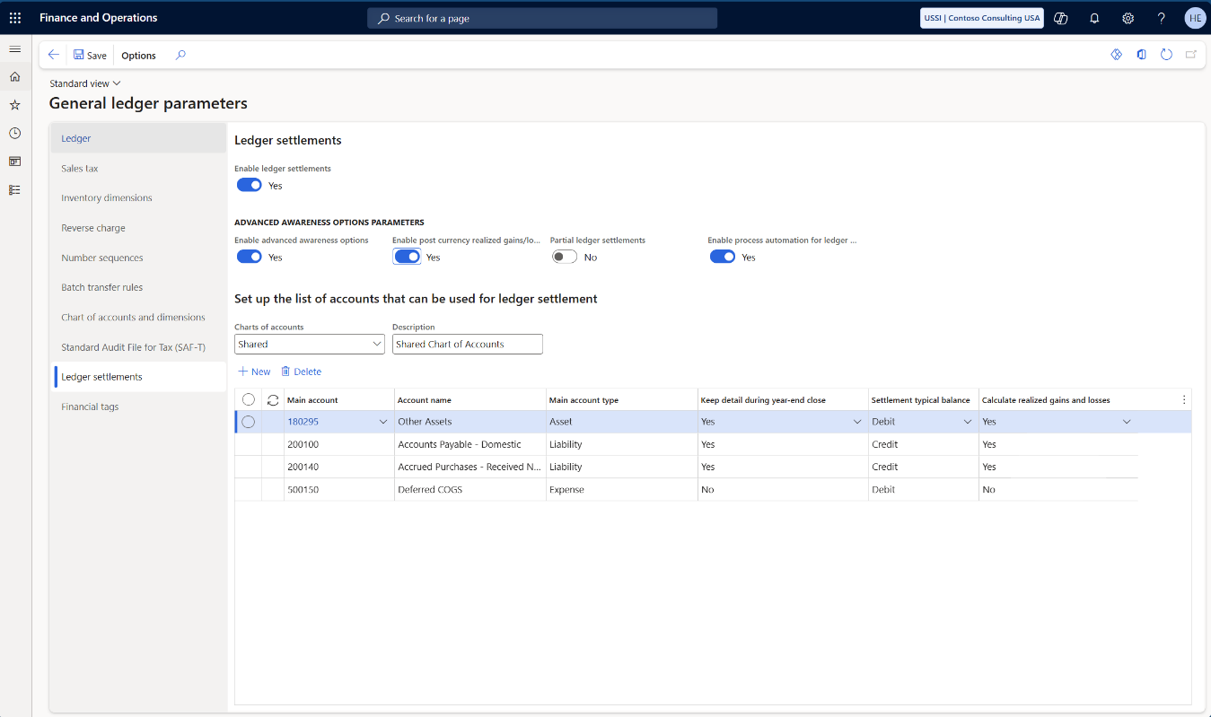
Realized gains/losses for ledger settlement
Notes:
You can enable post currency realized gains/losses for ledger settlement
You will now see an additional column for “calculate realized gains and losses” – if set to “yes” then D365FO will automatically account for the realized gain/loss for ledger settlement

Slide 41
Create currency gain/loss transaction from settlement

Slide 42
Create currency gain/loss transaction from settlement

Slide 43
Nice to know about realized gains/losses
If there is realized gain/loss for a ledger settlement, a new ledger transaction is posted, and automatically settled with the marked transactions
If a settlement with realized gain/loss is reversed, a new ledger transaction is posted to offset the original gain/loss, and the gain/loss transactions are automatically settled against each other
Notes:
So, what changes does the awareness options introduce compared to the

Slide 44
Recommendation(s)
Set “Calculate realized gains and losses” to “yes” for all main accounts that is set to “Keep details during year-end close”
Notes:
The recommendation is to set the “Calculate realized gains and losses” to “Yes” for all main accounts that is set to “Keep details during year-end close”
- If not, expect to manually adjust the gains and losses before performing year end close (more about this in our second session next week)

Slide 45
Partial ledger settlements

Slide 46
Be aware…
When “Partial ledger settlement” is enabled in the General Ledger parameters, all ledger settlement information will be transferred to a new table structure supporting partial settlements
This means that:
“Partial ledger settlement” cannot be disabled if it has been enabled
It is not possible to allow partial ledger settlements for some Main accounts – it is all Main accounts or none

Slide 47
Awareness options – GL parameters
Notes:
You can enable post currency realized gains/losses for ledger settlement
You will now see an additional column for “calculate realized gains and losses” – if set to “yes” then D365FO will automatically account for the realized gain/loss for ledger settlement

Slide 48
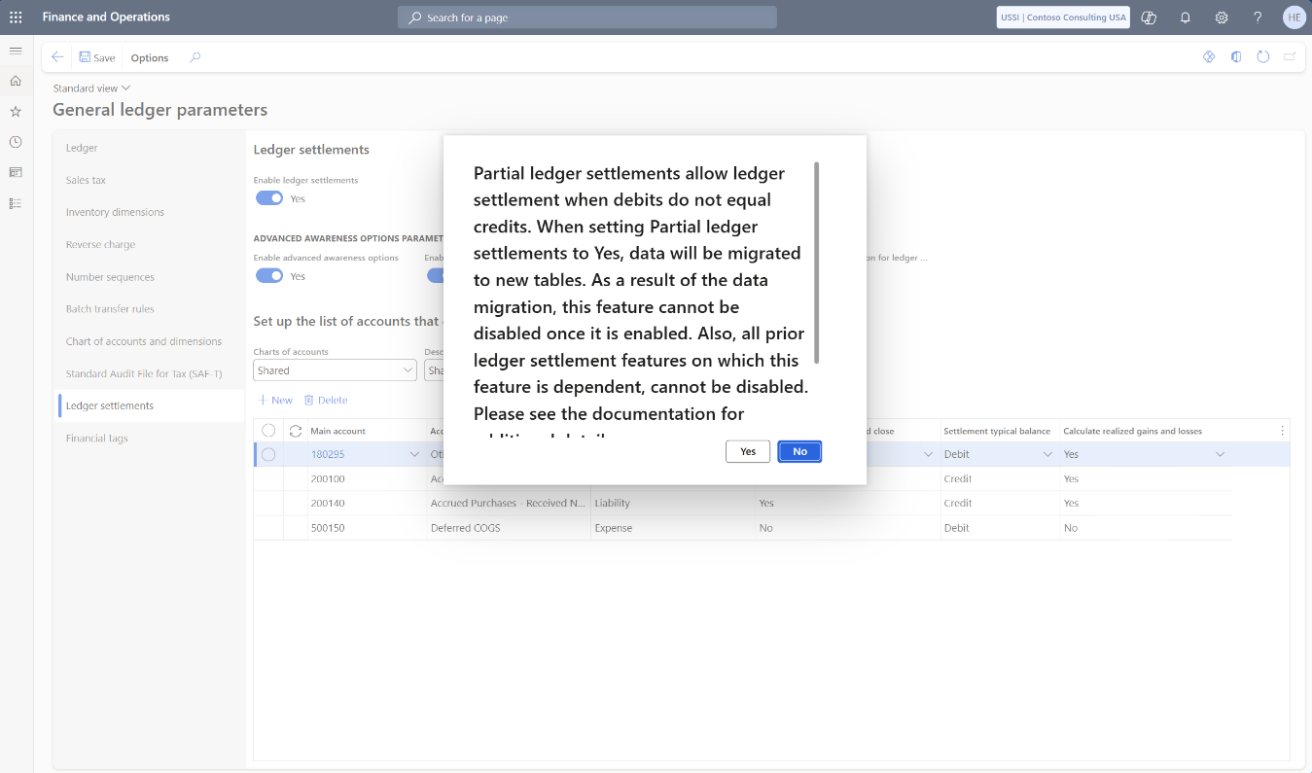
Partial ledger settlements
Notes:
You can enable post currency realized gains/losses for ledger settlement
You will now see an additional column for “calculate realized gains and losses” – if set to “yes” then D365FO will automatically account for the realized gain/loss for ledger settlement

Slide 49
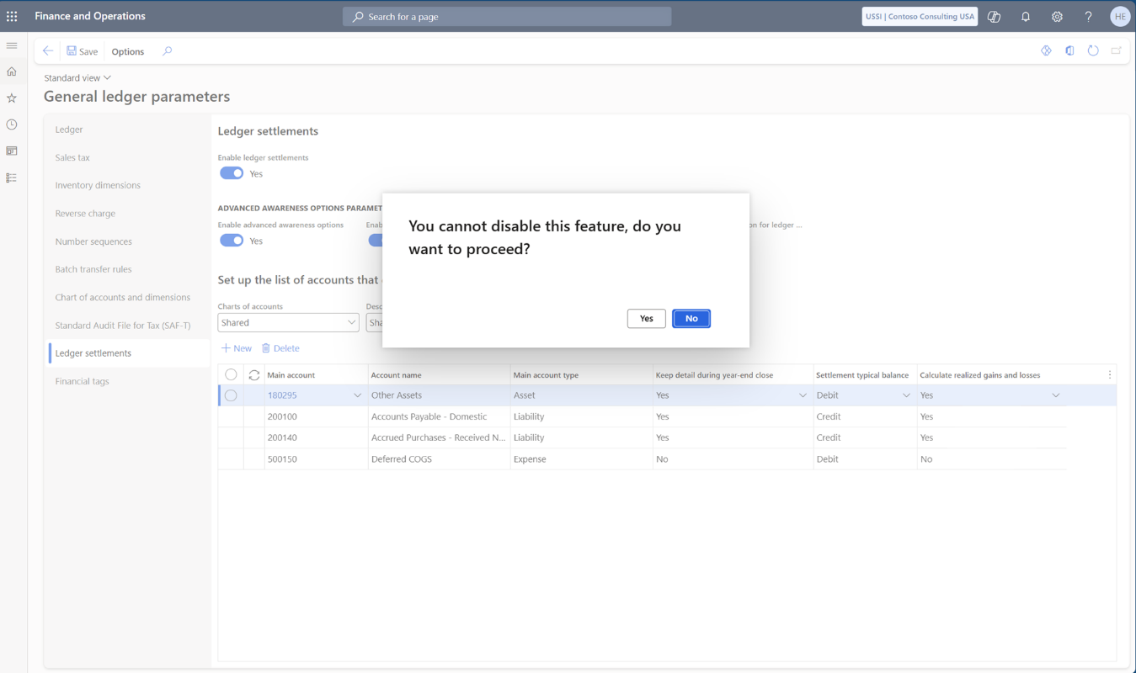
Partial ledger settlements
Notes:
You can enable post currency realized gains/losses for ledger settlement
You will now see an additional column for “calculate realized gains and losses” – if set to “yes” then D365FO will automatically account for the realized gain/loss for ledger settlement

Slide 50
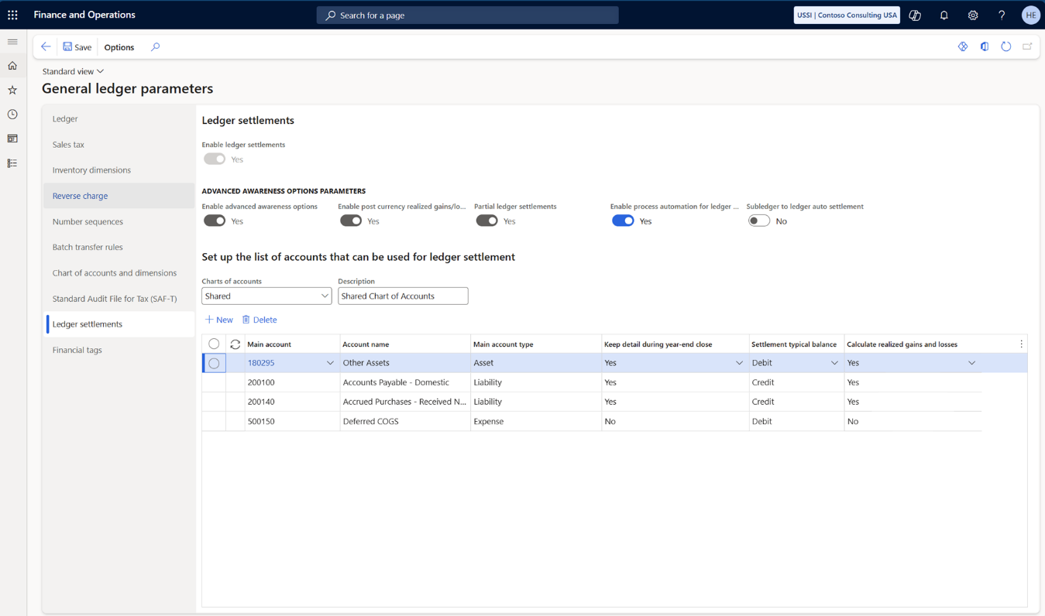
Partial ledger settlements
Notes:
You cannot undo the partial ledger settlement feature when it has first been enabled

Slide 51
Partial ledger settlements
Notes:
A new option has appeared – subledger to ledger auto settlement

Slide 52
Recommendation(s)
Only enable “Partial ledger settlements”, if there truly is requirement to be able to perform partial ledger settlements
  When enabled, it is not possible to enforce full settlement for specific main accounts
Notes:
When it is first enabled, it is not possible to disable it again
If you only want to enable partial ledger settlements for the auto settlement between subledger and ledger – I strongly recommend to use the subledger only

Slide 53
Bonus:
Optimize year-end close service

Slide 54
Optimize year end close service
Year-end close is executed as a microservice outside of D365FO
Improved year-end close performance
Must be installed from LCS, and enabled in Feature Management
Notes:
Run the year end close outside of D365FO
Performance – unscientific observations at customers are a saving of 40 to 60% of the processing time to close a year

Slide 55
Recommendation(s)
Install “Optimize year-end close” for all new environments
Enable the feature “Optimize year-end close” in Feature Management for all new environments
Notes:
When enabling advanced awareness options, there are many more opening transactions that will be created during year-end close – the unscientific performance gains I have experienced at customers are a saving of 40 to 60% in processing time

Slide 56
Resources and recommendations

Slide 57
Recommendations
All new environments
  Install “Optimize year-end close” service in LCS
  Enable “Optimize year-end close” in Feature Management

Slide 58
Recommendations
All new implementations
  Enable “Ledger settlement”
  Enable “Awareness between ledger settlement and year-end close”
  Enable “Post currency realized gains/losses for ledger settlement”
  Enable “Process automation for ledger settlement”
If you will not | Do
Use ledger settlement | Leave the list of main accounts for ledger settlement empty
Keep details | Set “Keep details during year-end close” to “No”
Post realized gains/losses for ledger settlement | Set “Calculate realized gains and losses” to “No”
Use process automation for ledger settlements | Leave the list of process automations for ledger settlement empty

Slide 59
Recommendations - continued
Do not enable “Partial ledger settlements” unless it is truly required

Slide 60
Additional resources
Learn articles
Ledger settlements - Finance | Dynamics 365 | Microsoft Learn
Awareness between ledger settlement and year-end close - Finance | Dynamics 365 | Microsoft Learn
Automate ledger settlements - Finance | Dynamics 365 | Microsoft Learn
Partial ledger settlements - Finance | Dynamics 365 | Microsoft Learn
Notes:
Links to relevant Docs
Links to relevant Learn
Links to other TechTalks
Links to Git Hub samples
Links to Blogs
Links to Forms surveys
Links to Yammer groups

Slide 61

QUESTIONS
61
Notes:
Henrik will hand it off to Saurabh for questions that have not yet been answered:

Slide 62
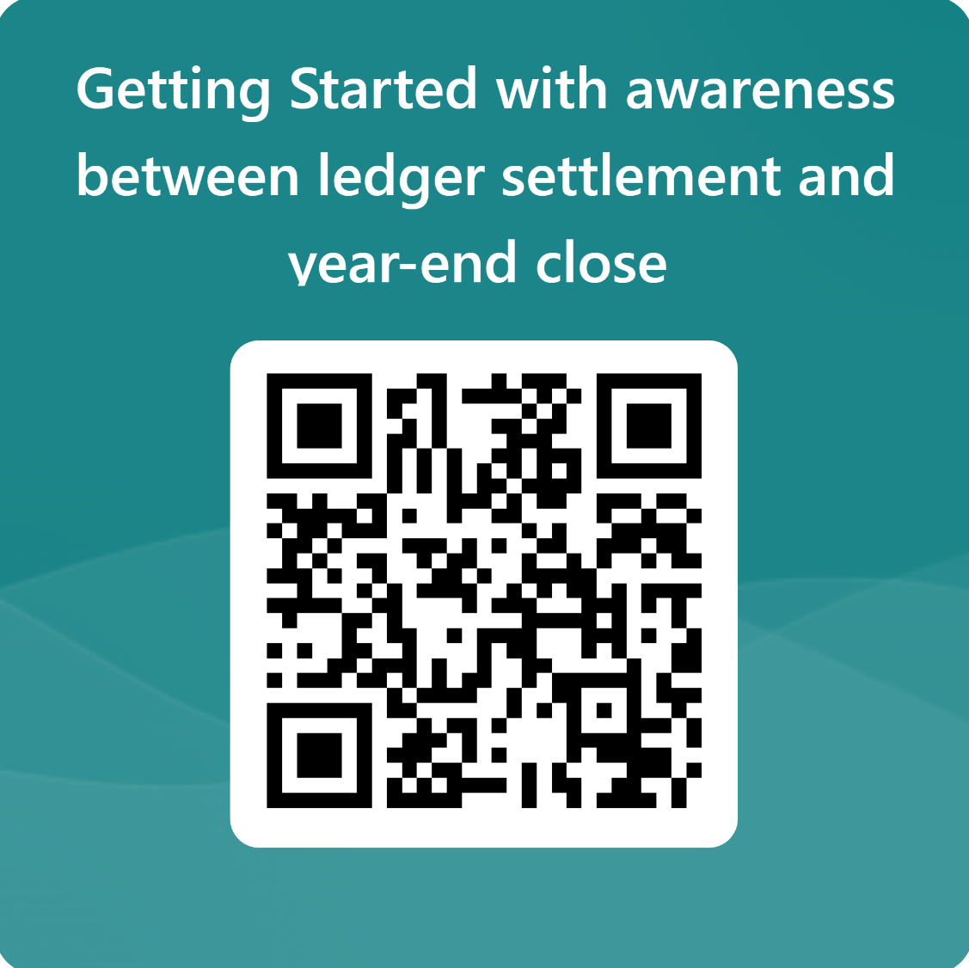
Please share your feedback
Notes:
To past in the chat https://forms.office.com/r/HLaQvDpETv

Slide 63
Thank you!
Dankie
Faleminderit
Shukran
Chnorakaloutioun
Hvala
Blagodaria
Děkuji
Tak
Dank u
Tänan
Kiitos
Merci
Danke
Ευχαριστώ
A dank
Mahalo
.תודה
Dhanyavād
Köszönöm
Takk
Terima kasih
Grazie
Grazzi
감사합니다
Paldies
Choukrane
Ačiū
Благодарам
ありがとうございました
谢谢
Баярлалаа
Dziękuję
Obrigado
Mulţumesc
Спасибо
Ngiyabonga
Ďakujem
Tack
Nandri
Kop khun
Teşekkür ederim
Дякую
Xвала
Diolch
63
Notes:
Henrik:
Thank you, I have posted a link to our short survey in the Q&A panel , we would love to hear your feedback on today's session and hear what you would like to see in the future events.
Thank you for your participation, as a reminder the recording of today's session will be made available on the Tech talks community dynamics page in coming weeks.
I would like to extend a big thank you to our presenters and to the audience who joined us today, Have a nice rest of your day everyone!
(Short survey link- paste it in the Q&A panel) - https://forms.office.com/r/HLaQvDpETv

Slide 64
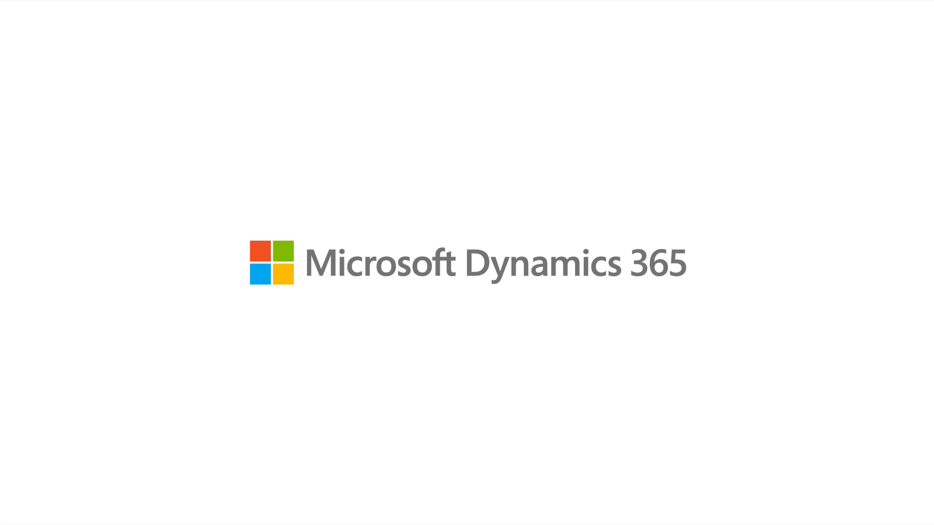
Notes:
End bumper – white

