Slide 1
Finance in M365 Copilot
Presenter(s):
Haytham Said

Slide 2
Agenda
Overview
Demo
Notes:
Ok so what are we going to cover today? We will start by talking about what asset management is, why we use it, and how we use it. Then we will cover the key concepts and terminology in the asset management area which will be built upon in further sessions. We will then have a brief demo of the module in Dynamics and wrap up by reviewing key resources with some time for Q&A at the end. This presentation will be a bit more slide-heavy but the next sessions will focus more on how we take these concepts and implement them in the system.

Slide 3
Finance In Microsoft 365 Copilot
Overview

Slide 4







Agents
Build &
Extend
Copilots & Agents
Account reconciliation Agent
(Dynamics 365 Finance)
Supplier Communications Agent
(Dynamics 365 Supply Chain)
Copilots
Time, Expense, Approvals
(Dynamics 365 Project Operations)
Data
Copilot Studio
Dynamics 365 Finance
Copilot for
Microsoft 365
Financial Reconciliation
(ERP agnostic)
Variance Analysis
(ERP agnostic)
Azure AI
Foundry
Collections (ERP agnostic)
Today
Today
Today and later 2025

Slide 5
Time could be better spent
13%
Identifying
performance issues
and opportunities
Enhancing
internal data with external insights
Negotiating
better terms or
prices with vendors
Only 13% of organizations identify performance issues before they hit financials.
Developing
and communicate KPIs
for cross-organization
use of resources
Supporting
ad-hoc reporting for specific and unique requests and issues
Source: Gartner: Managing Business Performance in Finance
Notes:
What does strategic work look like for finance professionals? How can time be better spent than on the drudgery? Well, there’s a lot of opportunity. Only 13% of organizations are identifying performance issues before they hit. Whether it’s looking externally to negotiate better terms or enhance internal data or supporting colleagues with ad-hoc requests to drive financial clarity, it’s clear that time can be better spent.

Slide 6
Finance in Microsoft 365 Copilot
Finance AI assistant, that helps verify facts, intelligently automate actions, and answer questions—making financial insights easier and more accessible to everyone.
Capabilities
Assistive workflows and AI actions in Microsoft Excel
Customer Communications
Financial Reconciliation
Variance Analysis
Financial Data Preparation
Answer debt related inquiries
Enables direct access to customer financial data within Outlook for sharing statements and managing customer interactions with ERP integration.
Compare data for accuracy
Automatically matches financial records across systems, flags discrepancies, and provides guided troubleshooting for efficient financial reconciliation.
Investigate financial results drivers
Detects anomalies and risks in financial data using natural language and structured criteria, producing annotated summaries and executive-ready reports.
Transform data for audit, reporting or analysis
Allows users to create data cleansing and formatting rules using natural language, with automated insights and reusable templates for streamlined data transformation.
Notes:
Branding update
Spectrum of capabilities
Focus today on Finance home

Slide 7
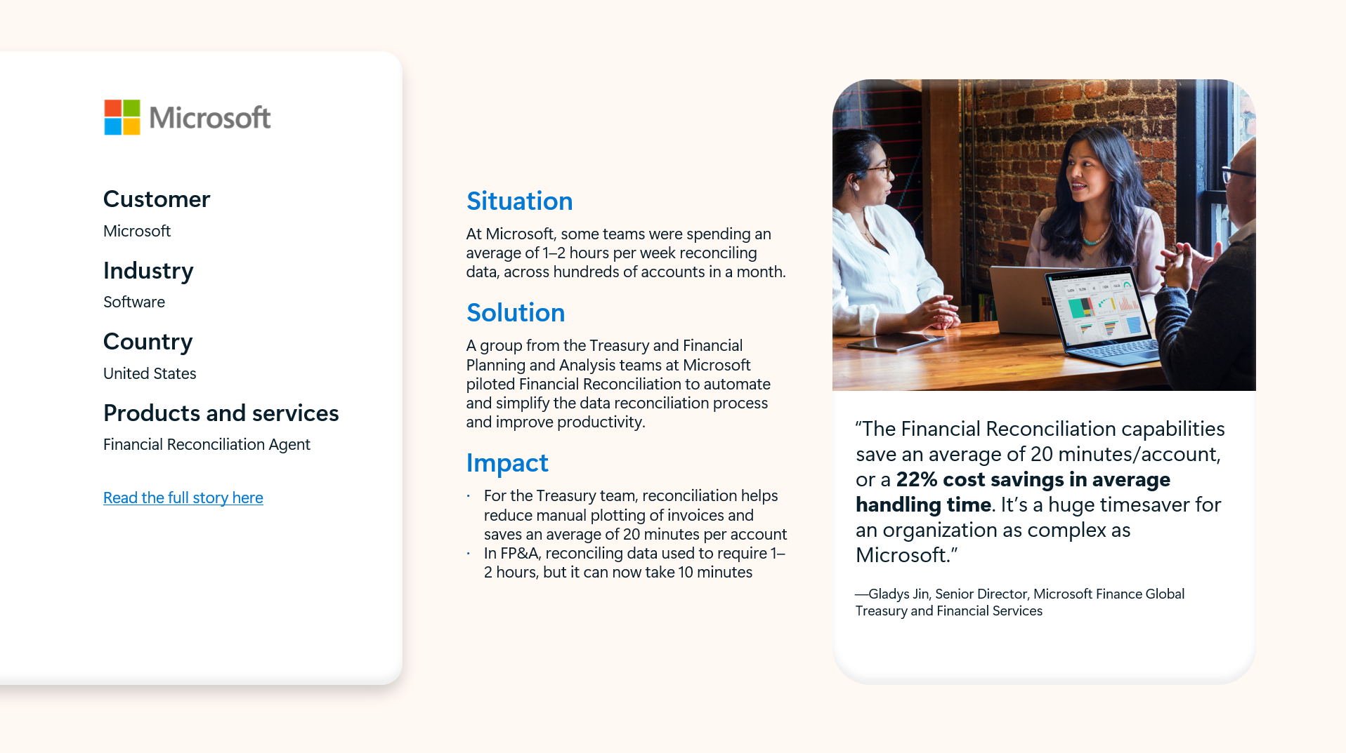

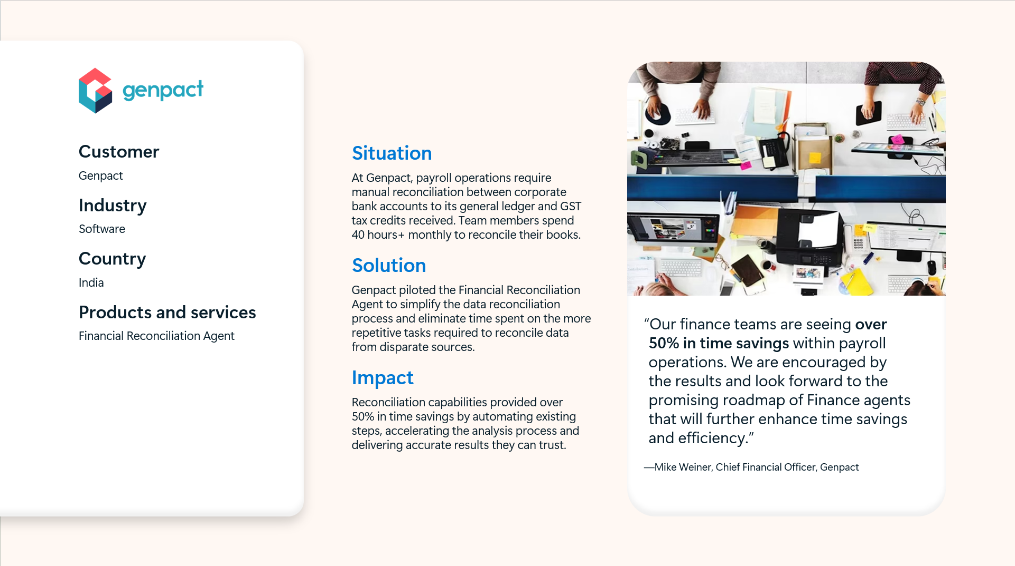
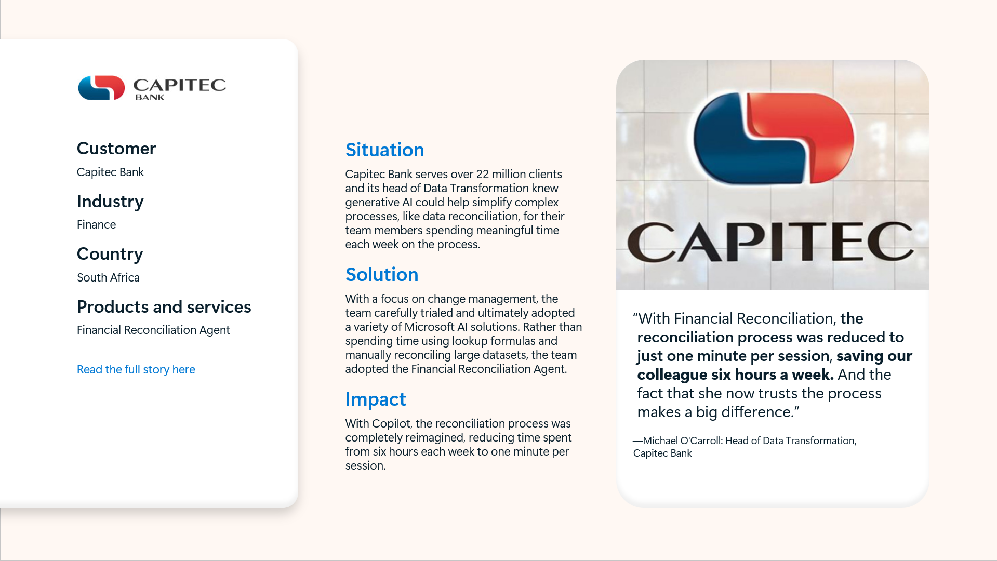
Finance in Microsoft 365 Use Cases
Leveraging intelligent automation to bring efficiency to real world financial scenarios
Financial Reconciliation
Variance analysis
D365 Finance GL
vs.
Non-D365 Subledger
Budget
vs.
Actual
Revenue
Variance
Intercompany
Customer Statements
vs.
D365 Finance Ledger
VAT
Reconciliation
Sales Forecast
vs.
Actual
FPA
Analysis
Restricted
Stock
Units
Ledger Payroll
vs
Payroll Provider
Working Capital
Variance Analysis
Profit
Variance
Notable Customer Use Cases
& Impact
Microsoft
Treasury & Fin Services
22% cost savings in average handling time
Willmott Dixon
HMRC – CIS Return
87% reduction in reconciliation time
Genpact
Payroll Operations
>50% in time savings in reconciliations
Capitec Bank
Financial Reporting
Reduced to 1 minute per session from 6 hours per week
Notes:
Overview
Evolving from C4F, Agents
GA

Slide 8
Demos
Haytham Said

Slide 9
Out-of-the-box Financial Reconciliation AI Action
File Upload trigger
Agent Trigger
Retrieve agent configuration
Power Automate
Retrieve template ID
Retrieve folder details
Retrieve recipient email addresses
Reconciliation and
Distribution
Power Automate
Read template details
Read Excel Source Data
Execute reconciliation
Generate & Save Report
Email recipients
Notes:
The reconciliation agent executes autonomous reconciliation in 3 stages:
First, the agent is triggered when (2) files are added to the source folder.
In the second stage, the agent retrieves details on the template, folder paths and recipients.
3. In the last stage, the agent executes the reconciliation

Slide 10
Sample Custom Financial Reconciliation Agent
Trigger - Email with Attachment Received
Agent Trigger
AP Statement received from customer.
Retrieve ERP Data and
configuration
Power Automate
Retrieve template ID
Retrieve folder details
Retrieve Customer ID from email sender
Reconciliation
and
Distribution
Power Automate
Read template details
Get ERP Data
Get Attachment Data
Execute reconciliation
Generate & Save Report
Send Teams Notification
Notes:
In the custom version of the agent you can see we have several opportunities to tweak the triggers, data source inputs and targets for output.

Slide 11
Sample Custom Financial Reconciliation using DMF
Trigger - Email with Attachment Received
Agent Trigger
AP Statement received from customer.
Retrieve Dynamics 365 Finance
Data and configuration
Power Automate
Execute DMF Export Project
Retrieve Execution ID
Retrieve Package and Extract it to Sharepoint
Reconciliation
and
Distribution
Power Automate
Read template details
Dynamics 365 Finance Data
Attachment Data
Execute reconciliation
Generate & Save Report
Send Teams Notification
Notes:
In the custom version of the agent you can see we have several opportunities to tweak the triggers, data source inputs and targets for output.

Slide 12
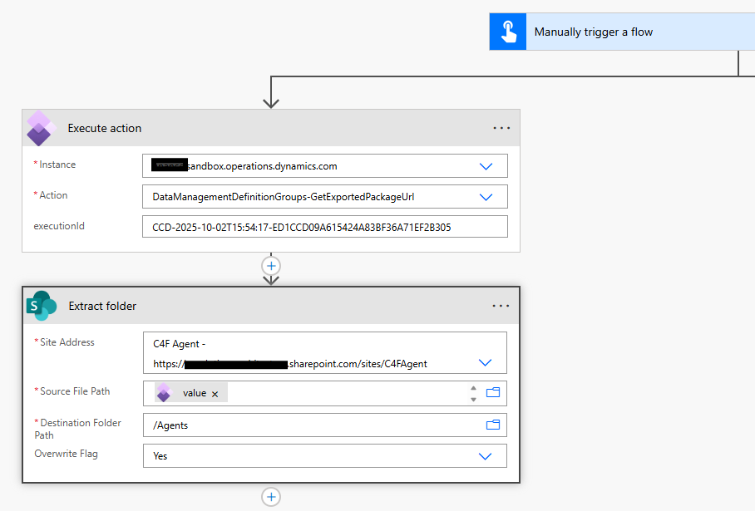

Slide 13
Sample Custom Financial Reconciliation using Odata
Trigger - Email with Attachment Received
Agent Trigger
AP Statement received from customer.
Retrieve Dynamics 365 Finance
Data and configuration
Power Automate
Get Data using Odata connector
Retrieve Data from Entity and format it as table
Extract it to Sharepoint
Reconciliation
and
Distribution
Power Automate
Read template details
Dynamics 365 Finance Data
Attachment Data
Execute reconciliation
Generate & Save Report
Send Teams Notification
Subject to ODATA limitation and it will require reasonable filtering criteria
Notes:
In the custom version of the agent you can see we have several opportunities to tweak the triggers, data source inputs and targets for output.

Slide 14
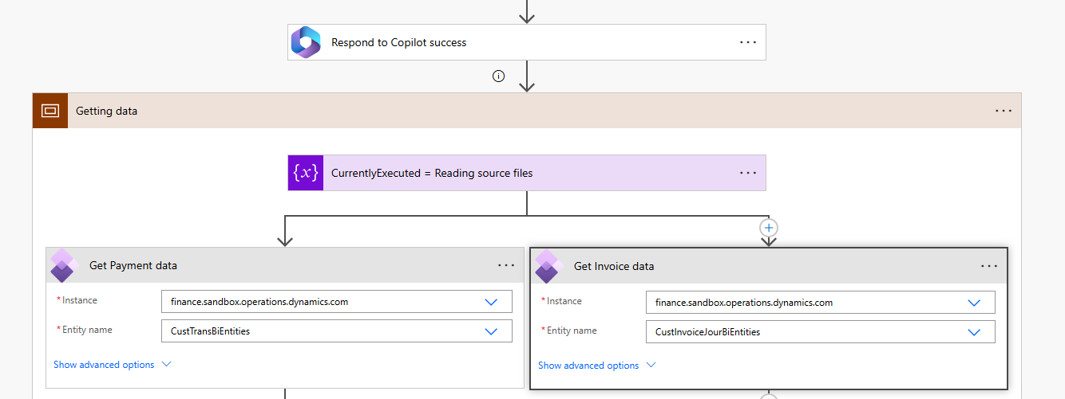

Slide 15
Sample Custom Financial Reconciliation Agent using Virtual Entities
Trigger - Email with Attachment Received
Agent Trigger
AP Statement received from customer.
Retrieve Dynamics 365 Finance
Data and configuration
Power Automate
Get Data using VE connector (List rows)
Retrieve Data from Entity and format it as table
Extract it to Sharepoint
Reconciliation
and
Distribution
Power Automate
Read template details
Dynamics 365 Finance Data
Attachment Data
Execute reconciliation
Generate & Save Report
Send Teams Notification
Require Dataverse and a linked Dynamics 365 Finance Environment and Have better performance than Odata connector
Notes:
In the custom version of the agent you can see we have several opportunities to tweak the triggers, data source inputs and targets for output.

Slide 16
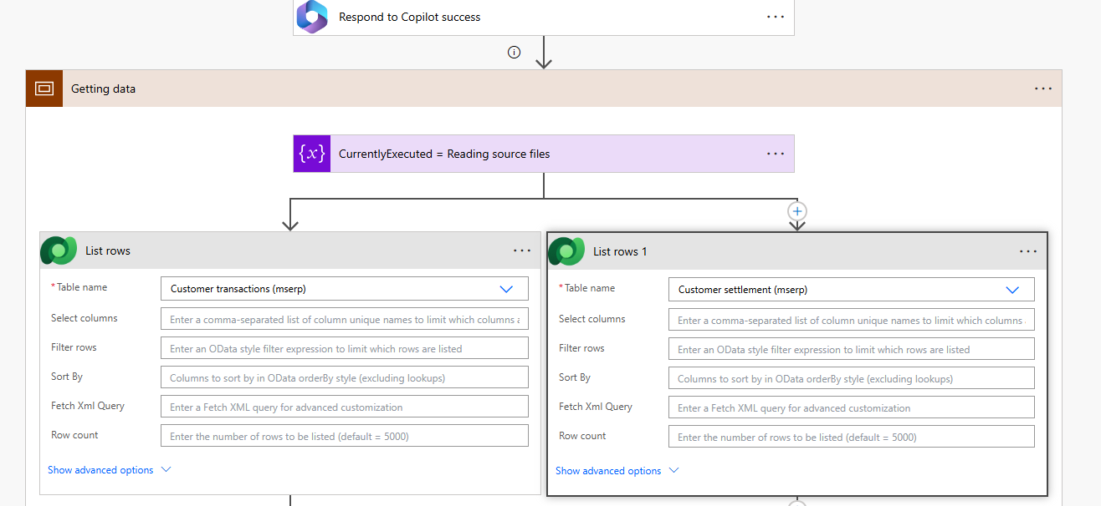

Slide 17
Additional resources
Welcome to Finance agents | Microsoft Learn
Finance in Microsoft 365 Copilot Series | Dynamics Bites Series
Finance in Microsoft 365 Copilot is now generally available
(20+) Viva Engage - Finance in Microsoft 365 Copilot
Notes:
Links to relevant Docs
Links to relevant Learn
Links to other TechTalks
Links to Git Hub samples
Links to Blogs
Links to Forms surveys
Links to Yammer groups

Slide 18

QUESTIONS
18

Slide 19
Thank you!
Dankie
Faleminderit
Shukran
Chnorakaloutioun
Hvala
Blagodaria
Děkuji
Tak
Dank u
Tänan
Kiitos
Merci
Danke
Ευχαριστώ
A dank
Mahalo
.תודה
Dhanyavād
Köszönöm
Takk
Terima kasih
Grazie
Grazzi
감사합니다
Paldies
Choukrane
Ačiū
Благодарам
ありがとうございました
谢谢
Баярлалаа
Dziękuję
Obrigado
Mulţumesc
Спасибо
Ngiyabonga
Ďakujem
Tack
Nandri
Kop khun
Teşekkür ederim
Дякую
Xвала
Diolch
19

