Slide 1
Adopting
Awareness between ledger settlement and Year-End Close after Go-live
Presenter:
Henrik Jaeger – Sr. FastTrack Solution Architect
Moderator/Q&A:
Saurabh Bharati – Sr. FastTrack Solution Architect
Notes:
Saurabh:
Hello everyone and welcome to today's Dynamics 365 TechTalk. Today's topic is Adopting Awareness between ledger settlement and year-end close after go-live’. My name is Saurabh, and I will be your moderator today.
We are broadcasting this session through Teams Town Hall. This session is being recorded on behalf of the Microsoft Corporation. When you join this event, your name and e-mail address may be viewable by session organizers. By joining you're agreeing to this experience. If you do not consent to be a part of a recorded session, please disconnect your line at this time. The recording will be made available in the TechTalk section of Community Dynamics page within 5 business days.
If you have questions for the presenter or need support, please use the Q&A panel located on the right side of your screen. If you wish your name not to be visible to organizers or session participants, please post your questions anonymously. We will be responding to your questions throughout the session and in a live segment at the end of the presentation. ​​​​​​​
Thank you for your patience during these announcements.
Presenting for us today from Microsoft we have Henrik, Senior FastTrack Solution Architect.
Henrik, over to you!

Slide 2
TechTalk Series
Session 1 – Getting started with Awareness between ledger settlement and year-end close (September 16, 2025)
Session 2 – Adopting Awareness between ledger settlement and year-end close after go-live
Notes:
This is the second TechTalk in a series of 2 TechTalks that will dive into the details of the Awareness between ledger settlement and year-end close in Dynamics 365 Finance. This TechTalk will be focusing on adopting awareness between ledger settlement and year-end close in legal entities that are already live and transacting.

Slide 3
Take aways
Approach to adopting Awareness between ledger settlement and year-end close in a transacting (live) legal entity
Understand the “full” vs “delta” year-end close methods
Understand the importance of taking control over settings impacting year-end close

Slide 4
Key changes by enabling Awareness between ledger settlement and year-end close

Slide 5
Awareness between ledger settlement and YeC
Key changes
Only un-settled transactions are included in year-end close
Ledger settlement must be within one main account
Ledger settlement cannot be across fiscal years
If the Keep detail during year-end close option is marked, the year-end close will create detailed opening balance transactions
Notes:
Recap from session 1 – these changes are the cause of all challenges encountered when adopting awareness between ledger settlement and year-end close in a legal entity already transacting (have gone live)

Slide 6
Year-end close challenges with Awareness between ledger settlement and year-end close

Slide 7
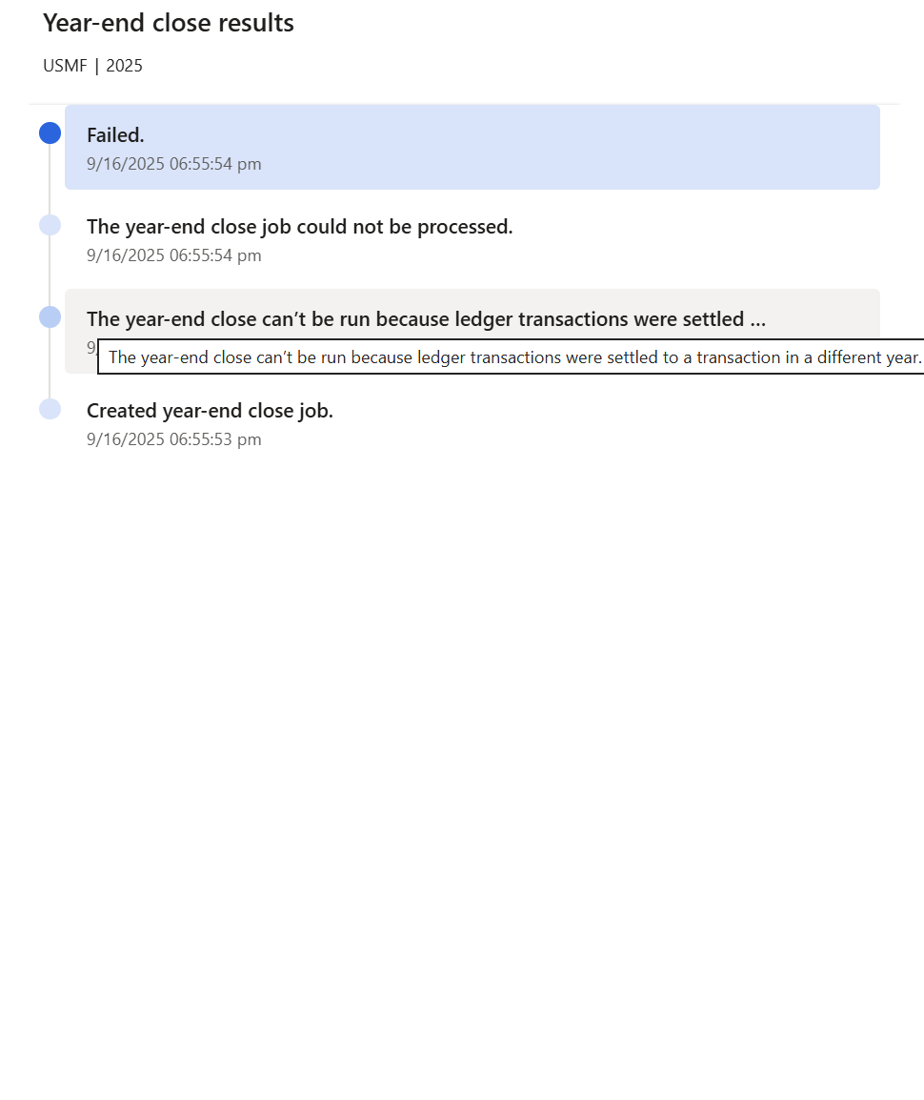
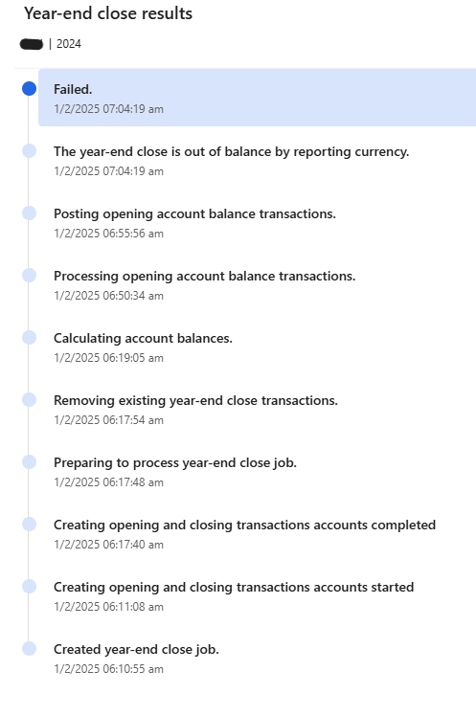
After enabling Awareness…

Slide 8
Out of balance errors – the usual suspects
Settlements across fiscal years (accounting and reporting currency)
Exchange rate differences (reporting currency)

Slide 9
Out of balance errors – also observed
Custom auto-settlement function that didn’t check if debit and credit balanced within a settlement ID
Custom integration that didn’t use the financial journal framework to post GL transactions (e.g., rounding error at 7th decimal place)
Customization allowing users to update amounts on already posted transactions

Slide 10
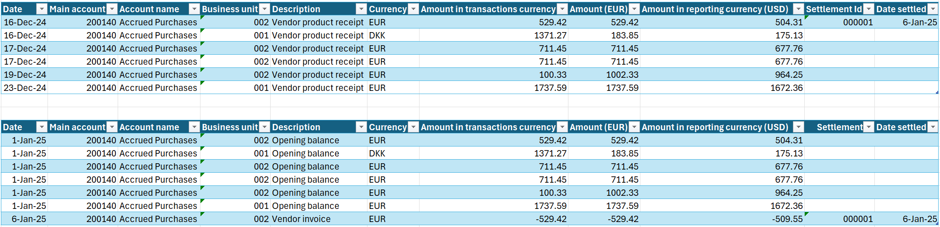
Cross-year settlements - example
Year-end close only includes un-settled transactions, hence there will be a difference between debit and credit in fiscal year 2024 of EUR 529.42.

Slide 11
An approach to adoption of Awareness between ledger settlement and year-end close

Slide 12
Initial year-end close
Configure Awareness between ledger settlement and year-end close in legal entity
Notes:
Fiscal year has not previously been closed

Slide 13
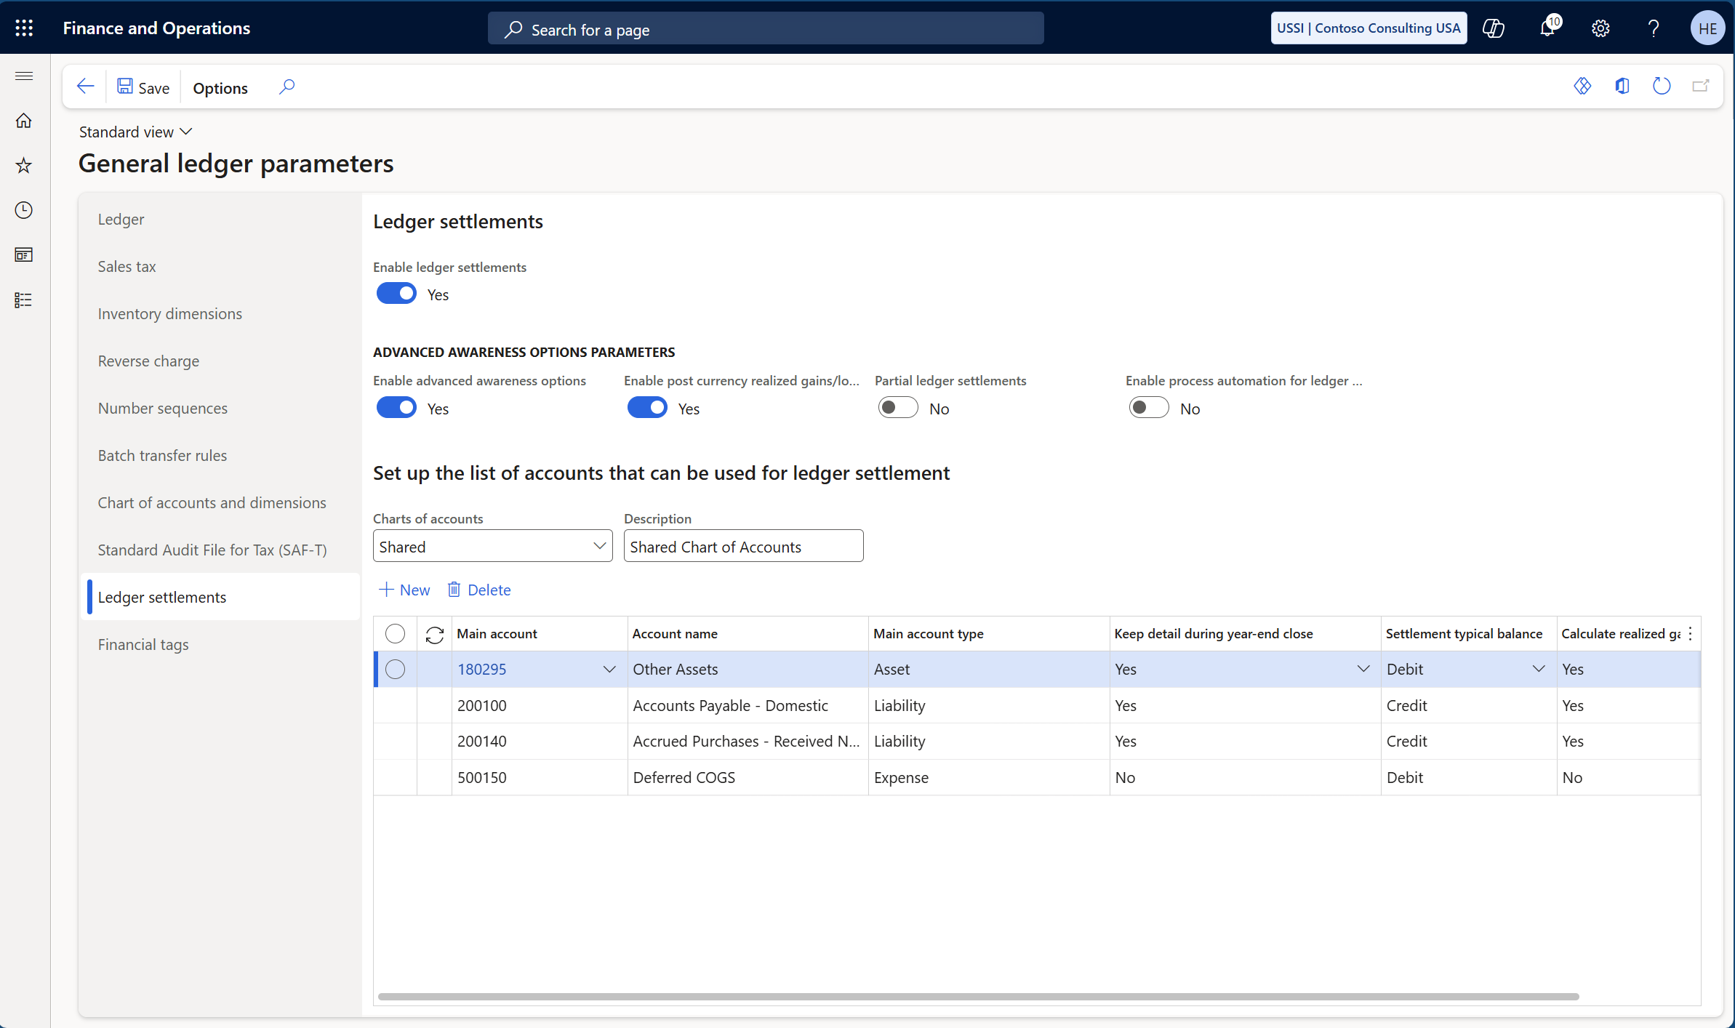
Configure Awareness between ledger settlement and year-end close
Notes:
General Ledger / Periodic tasks / Ledger settlement > Review missing settlement accounts

Slide 14
Initial year-end close
Configure Awareness between ledger settlement and year-end close in legal entity
Include all main accounts used in ledger settlements
Notes:
Fiscal year has not previously been closed

Slide 15
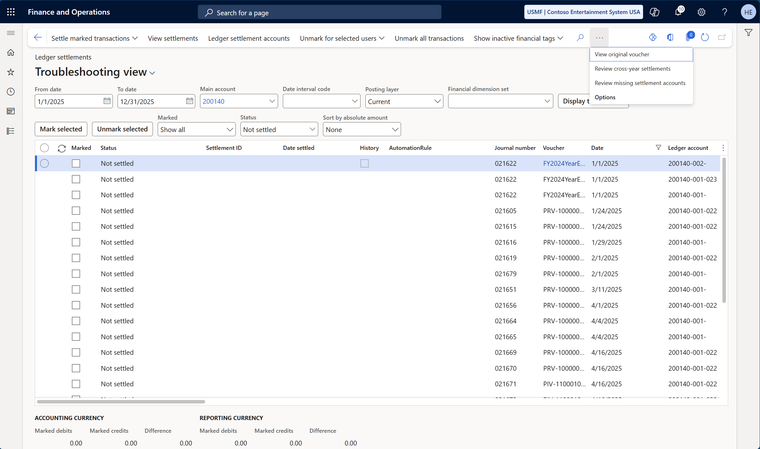
Include all main accounts used in ledger settlements
Notes:
General Ledger / Periodic tasks / Ledger settlement > Review missing settlement accounts

Slide 16
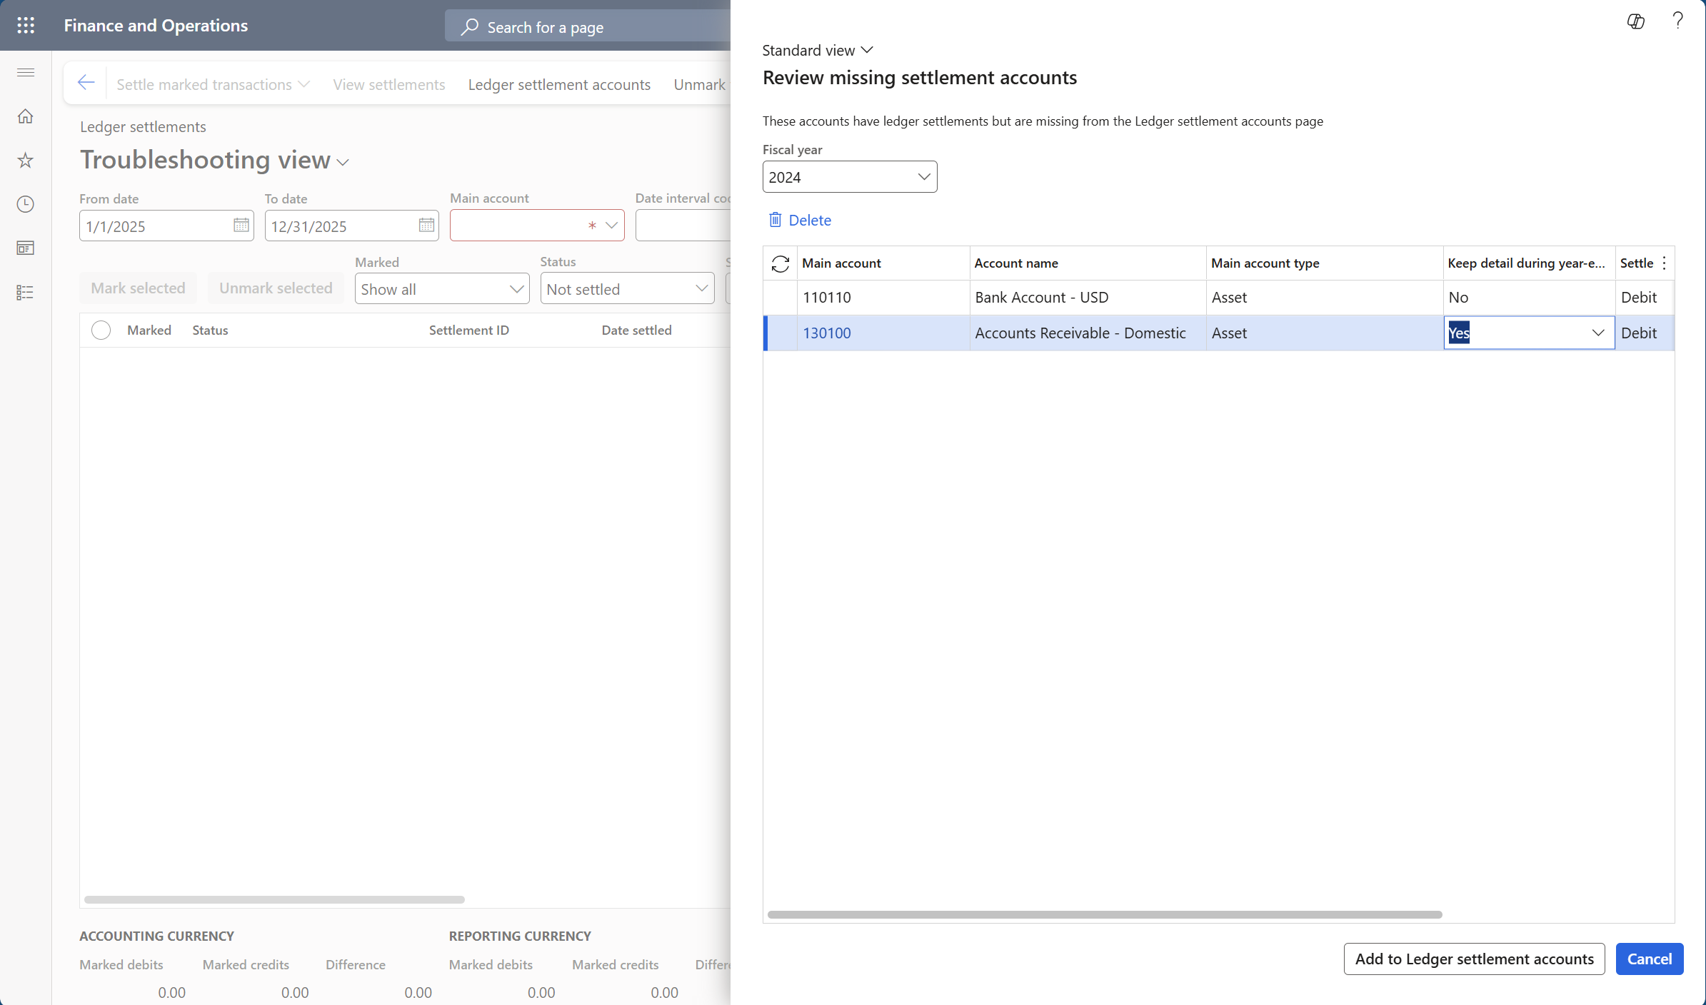
Include all main accounts used in ledger settlements

Slide 17
Initial year-end close
Configure Awareness between ledger settlement and year-end close in legal entity
Include all main accounts used in ledger settlements
Unsettle all cross-year settlements

Slide 18
Unsettle all cross-year settlements
Notes:
General Ledger / Periodic tasks / Ledger settlement > Review cross-year settlements

Slide 19
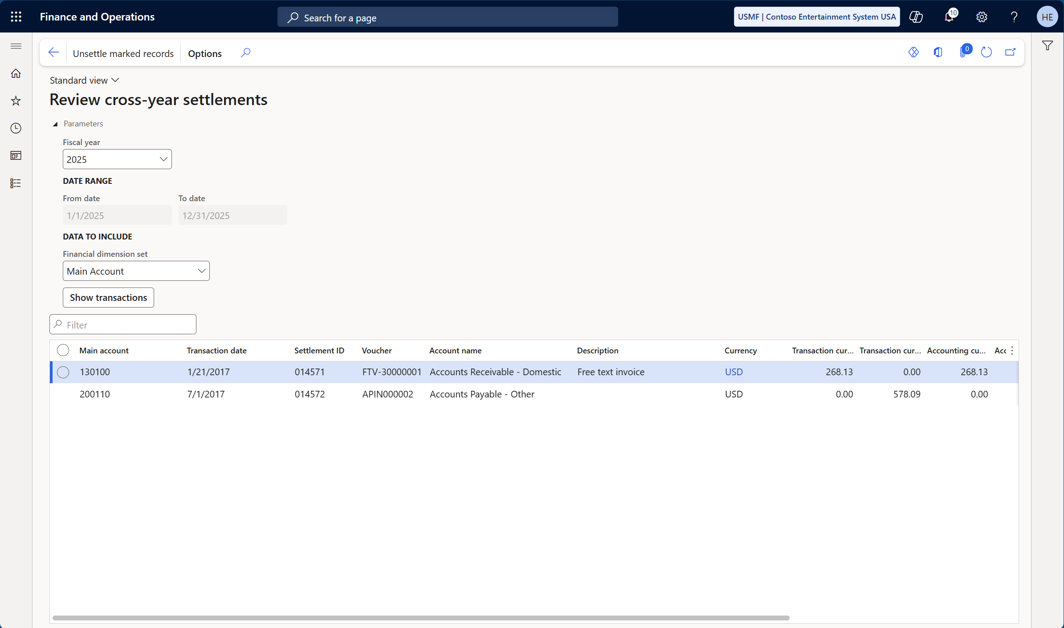
Unsettle all cross-year settlements

Slide 20
Initial year-end close
Configure Awareness between ledger settlement and year-end close in legal entity
Include all main accounts used in ledger settlements
Unsettle all cross-year settlements
Unsettle all ledger settlement IDs that does not balance (debit/credit) in accounting currency

Slide 21
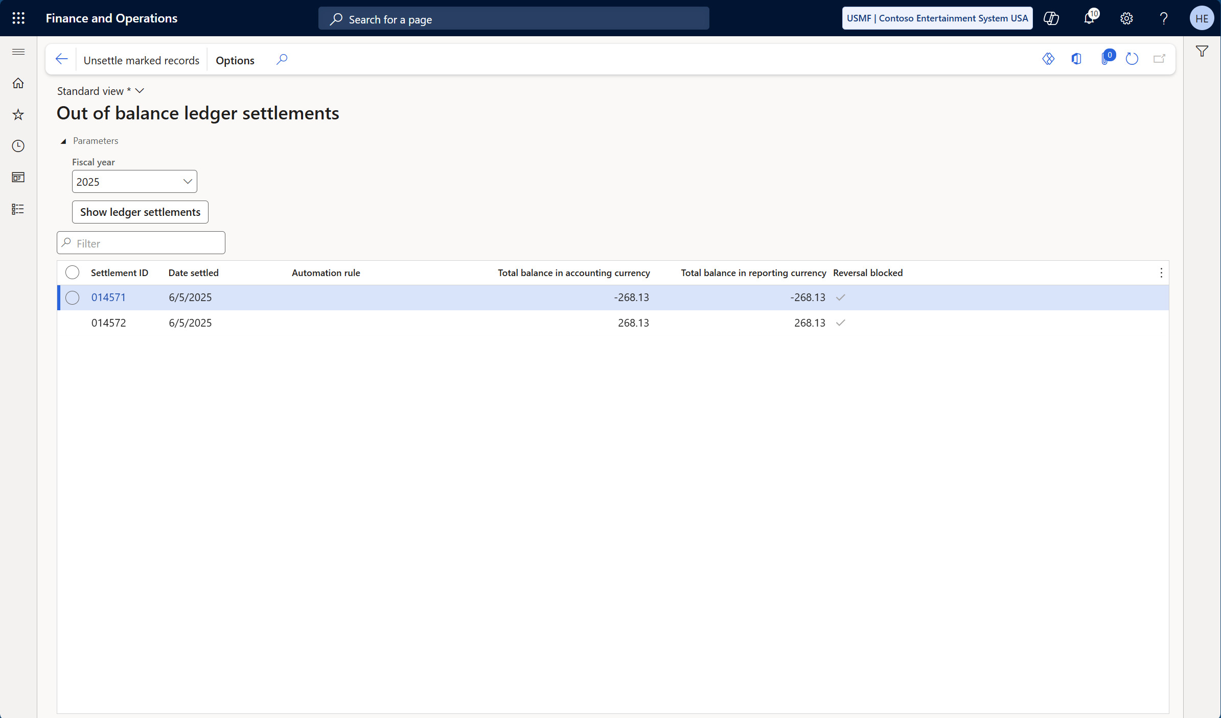
Unsettle all ledger settlement IDs that does not balance (debit/credit) in accounting currency
Notes:
General Ledger / Periodic tasks / Out of balance ledger settlements
New function in 10.0.45

Slide 22
Initial year-end close
Configure Awareness between ledger settlement and year-end close in legal entity
Include all main accounts used in ledger settlements
Unsettle all cross-year settlements
Unsettle all ledger settlement IDs that does not balance (debit/credit) in accounting currency
Account for currency gains/losses for settled ledger transactions

Slide 23
Account for currency gains/losses for settled ledger transactions
Notes:
General Ledger / Periodic tasks / Out of balance ledger settlements
New function in 10.0.45

Slide 24
Account for currency gains/losses (by settlement)
Unsettle all ledger settlement IDs that does not balance (debit/credit) in reporting currency
Re-settle all ledger settlements unsettled in step 1 with “enable post currency realized gains/losses for ledger settlements” enabled

Slide 25
Account for currency gains/losses (in bulk)
Identify the total “out of balance” for each main account with ledger settlements
Create and post a Reporting currency adjustment journal for each main account in step 1
Create and post a General journal for each main account in step 2, with two journal lines per main account – one with 1.00 in debit and the other with 1.00 in credit
Settle the reporting currency adjustment with the debit and credit posting (step 3) for each main account

Slide 26
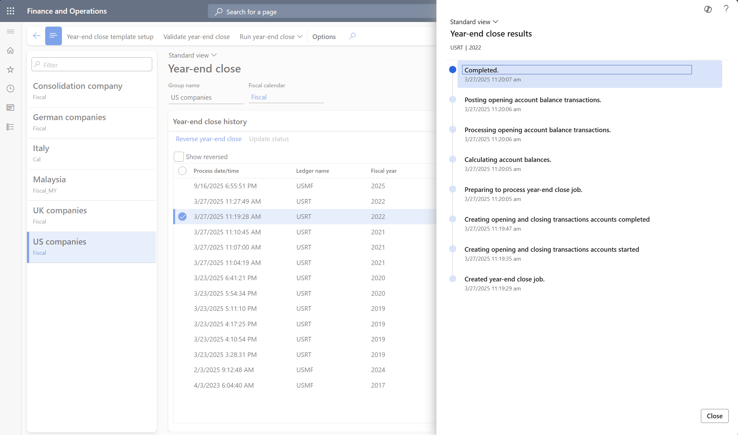
Run year-end close

Slide 27
Considerations for re-closing a fiscal year

Slide 28
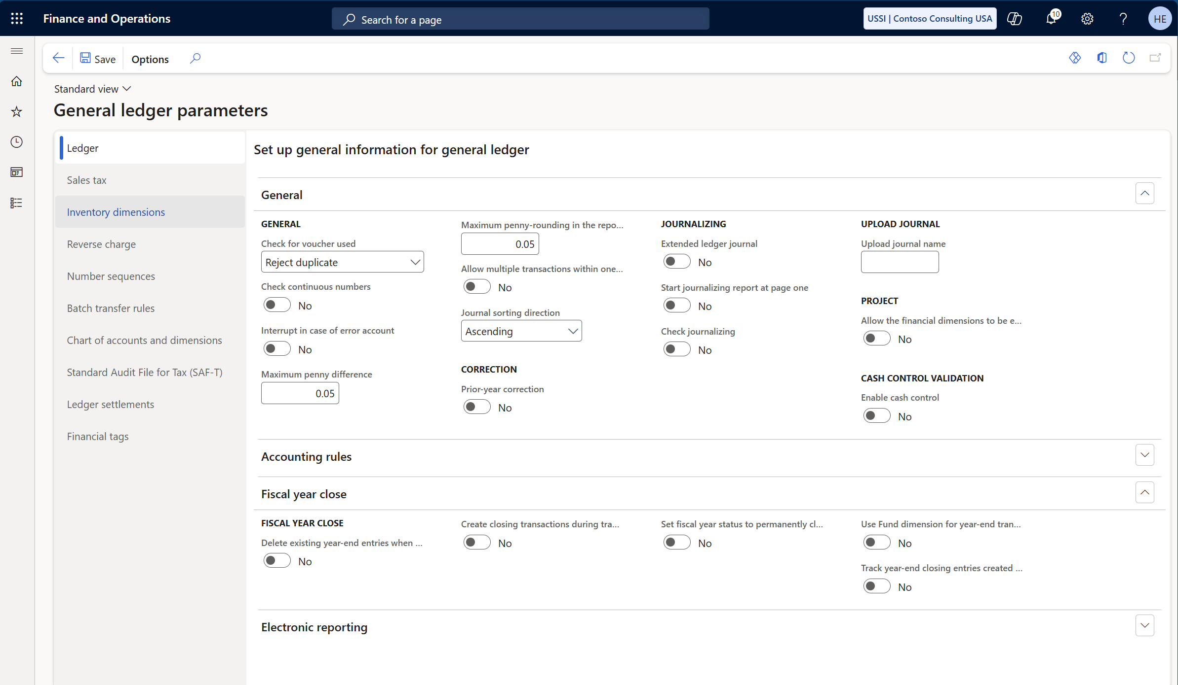
“Full” vs “delta” year-end close
Notes:
Also known as “delete existing year-end entries when re-closing the year”
If set to “yes” = full year-end close method
If set to “no” = delta year-end close method

Slide 29
The challenge with the “full” year-end close method
It is not possible to reverse a year-end close, if any of the opening transactions in the new year has been settled
  Therefore, you must unsettle all opening transactions before you can reverse a year end close (or re-close a year with “delete existing year-end entries when re-closing the year” set to “yes”)

Slide 30
Recommendation(s)
Adopt the “delta” year-end close methods, where only the adjustments made after the initial year-end close will be transferred as opening transactions (“delete existing year-end entries when re-closing the year” = No)
Notes:
The recommendation is to set the “Calculate realized gains and losses” to “Yes” for all main accounts that is set to “Keep details during year-end close”
- If not, expect to manually adjust the gains and losses before performing year end close (more about this in our second session next week)

Slide 31
Taking control of settings impacting year-end close

Slide 32
Why is it important to take control over these settings
It is possible to make changes that will result is a “delta” year-end close not being possible
  Changing the “opening account” on a main account
  Changing the “keep detail” setting for one or more main accounts
  Making changes to the “year-end close template setup”
In this situation, you’re only option is the revert the changes made (so that it matches the settings at the time of the initial year-end close for the year)
…or reverse the year-end close for the year

Slide 33
Recommendation(s)
Configure the Database log to capture changes to the following tables:
  Fiscal close group
  Fiscal close ledger options
  Ledger parameters
  Ledger settlement accounts
  Main account
Notes:
As none of these will impact transaction processing in Finance & Operations, you can set them up to capture “insert”, “update”, “delete” and “rename key”

Slide 34
Last resort

Slide 35
Last resort
NB! This is not a recommendation; it is a last resort when all other options have been exhausted
In a situation where the described actions to adopt the Awareness between ledger settlement and year-end close are too overwhelming, consider an approach where:
  Year-end close is performed with the “advanced awareness options” disabled (and only after all corrections have been posted in the fiscal year)
  Create and post General journal(s) that post the detailed opening transactions (unsettled transactions) with an offset transaction matching the summary opening transaction posted through year-end close
  Don’t forget to configure awareness between ledger settlement and year-end close after year-end close
  NB! You will still need to “clean up” all ledger settlements performed between start of the new fiscal year, and performing the year-end close as described above

Slide 36
Resources and recommendations

Slide 37
Recommendations
Update to version 10.0.45
Adopt Awareness between ledger settlement and year-end close
Adopt the “delta” year-end close method
Take control over settings impacting year-end close
  Limit user access
  Configure the Database log
Before unsettling any ledger settlements, make an export to Excel from the Ledger Settlement form
Create a specific “troubleshooting view” in the Ledger Settlement form, where RecId (Ledger settlement) and Absolute amount

Slide 38
Additional resources
Learn articles
Ledger settlements - Finance | Dynamics 365 | Microsoft Learn
Awareness between ledger settlement and year-end close - Finance | Dynamics 365 | Microsoft Learn
Automate ledger settlements - Finance | Dynamics 365 | Microsoft Learn
Partial ledger settlements - Finance | Dynamics 365 | Microsoft Learn
Notes:
Links to relevant Docs
Links to relevant Learn
Links to other TechTalks
Links to Git Hub samples
Links to Blogs
Links to Forms surveys
Links to Yammer groups

Slide 39

QUESTIONS
39
Notes:
Henrik will hand it off to Saurabh for questions that have not yet been answered:

Slide 40
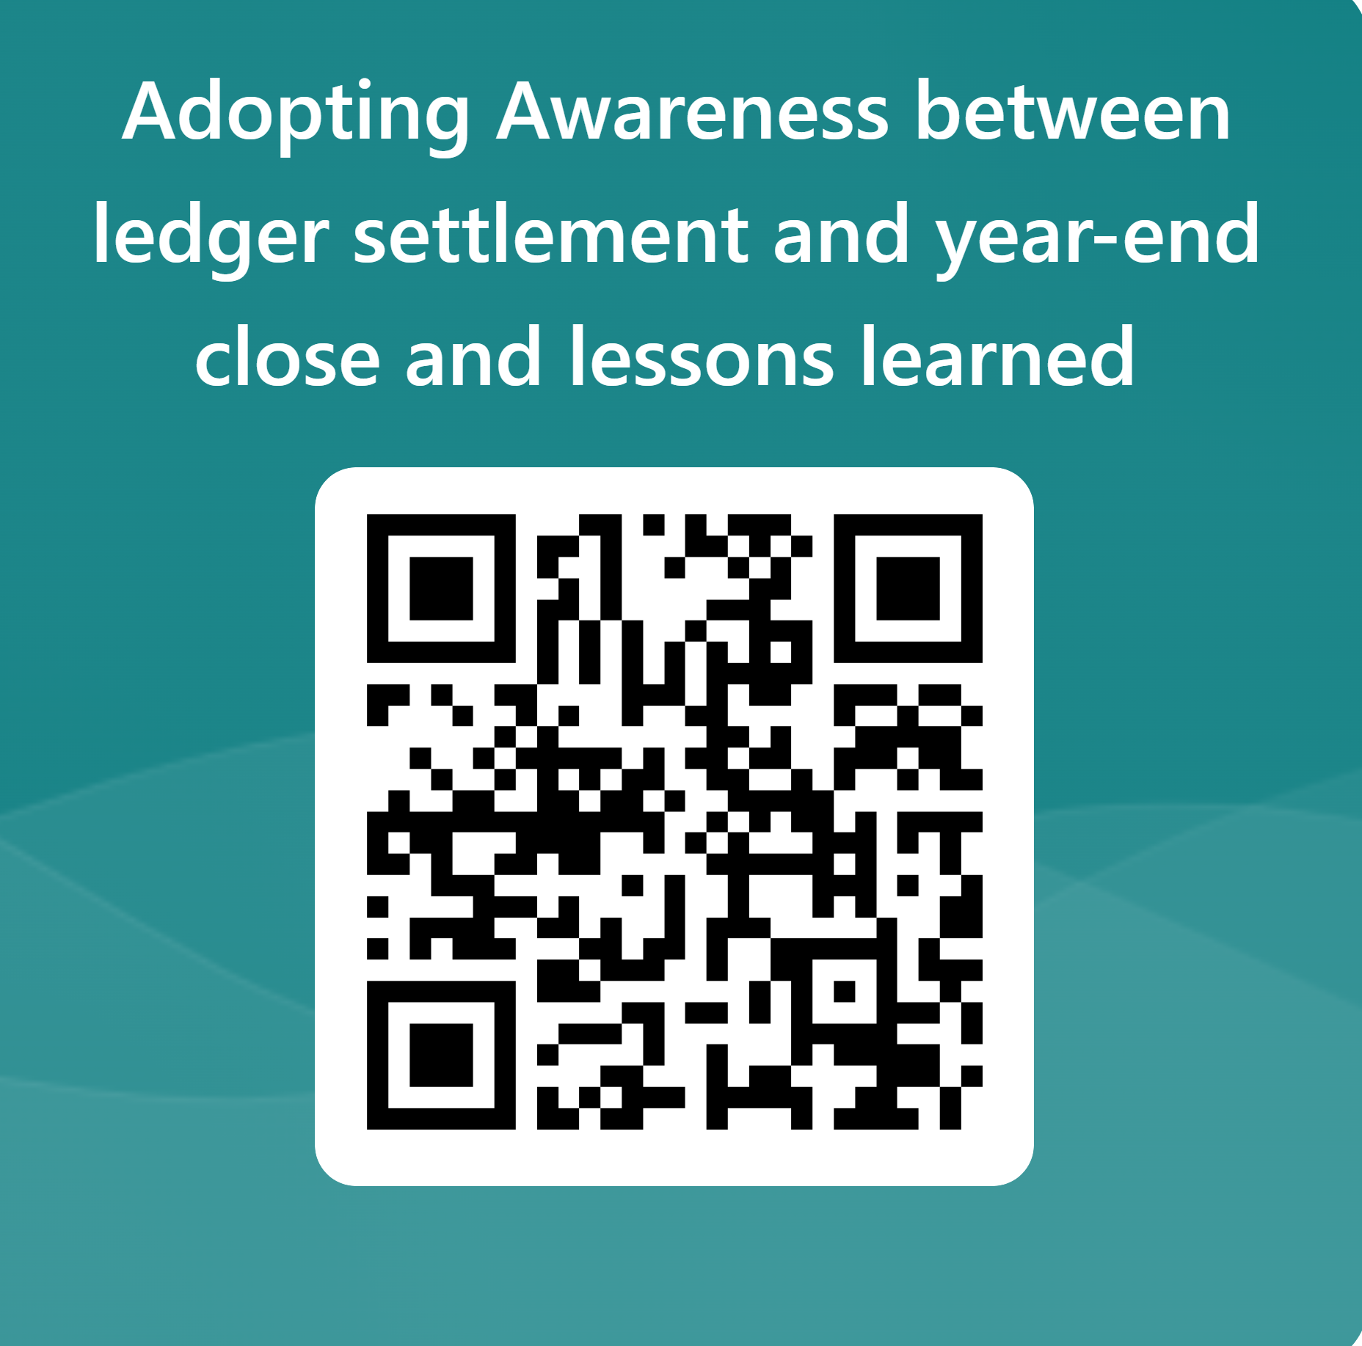
Please share your feedback
Notes:
To past in the chat https://forms.office.com/r/iKV4c0eBLy

Slide 41
Thank you!
Dankie
Faleminderit
Shukran
Chnorakaloutioun
Hvala
Blagodaria
Děkuji
Tak
Dank u
Tänan
Kiitos
Merci
Danke
Ευχαριστώ
A dank
Mahalo
.תודה
Dhanyavād
Köszönöm
Takk
Terima kasih
Grazie
Grazzi
감사합니다
Paldies
Choukrane
Ačiū
Благодарам
ありがとうございました
谢谢
Баярлалаа
Dziękuję
Obrigado
Mulţumesc
Спасибо
Ngiyabonga
Ďakujem
Tack
Nandri
Kop khun
Teşekkür ederim
Дякую
Xвала
Diolch
41
Notes:
Henrik:
Thank you, I have posted a link to our short survey in the Q&A panel , we would love to hear your feedback on today's session and hear what you would like to see in the future events.
Thank you for your participation, as a reminder the recording of today's session will be made available on the Tech talks community dynamics page in coming weeks.
I would like to extend a big thank you to our presenters and to the audience who joined us today, Have a nice rest of your day everyone!
(Short survey link- paste it in the Q&A panel) - https://forms.office.com/r/HLaQvDpETv

Slide 42
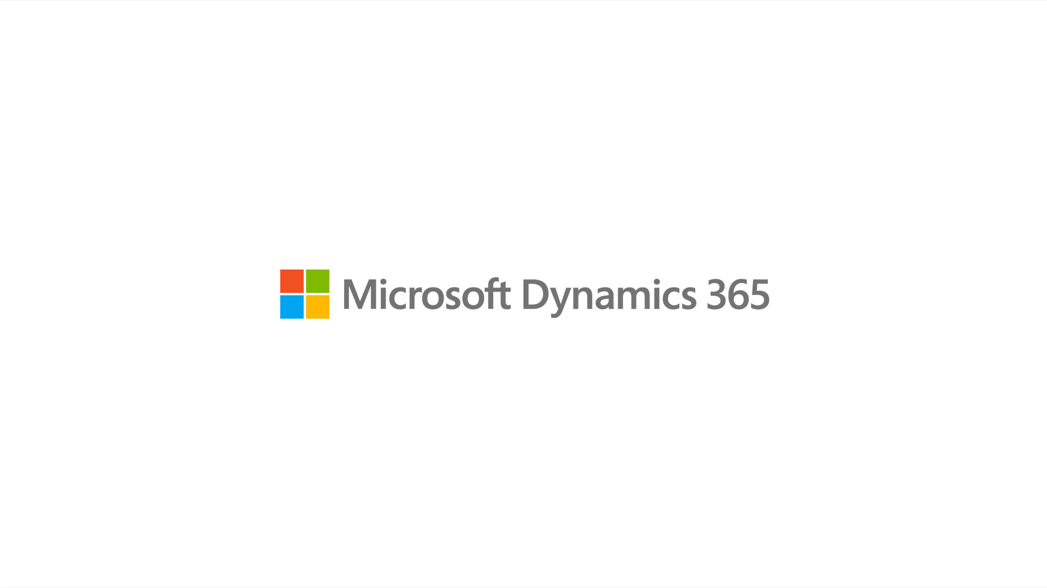
Notes:
End bumper – white

Slide 43
I enabled “awareness options”, but it didn’t work…
Find a better slide title!
Year-end close fails
This is caused by changes made to how year-end close is performed with and without “advanced awareness options” enabled

